Slide 1
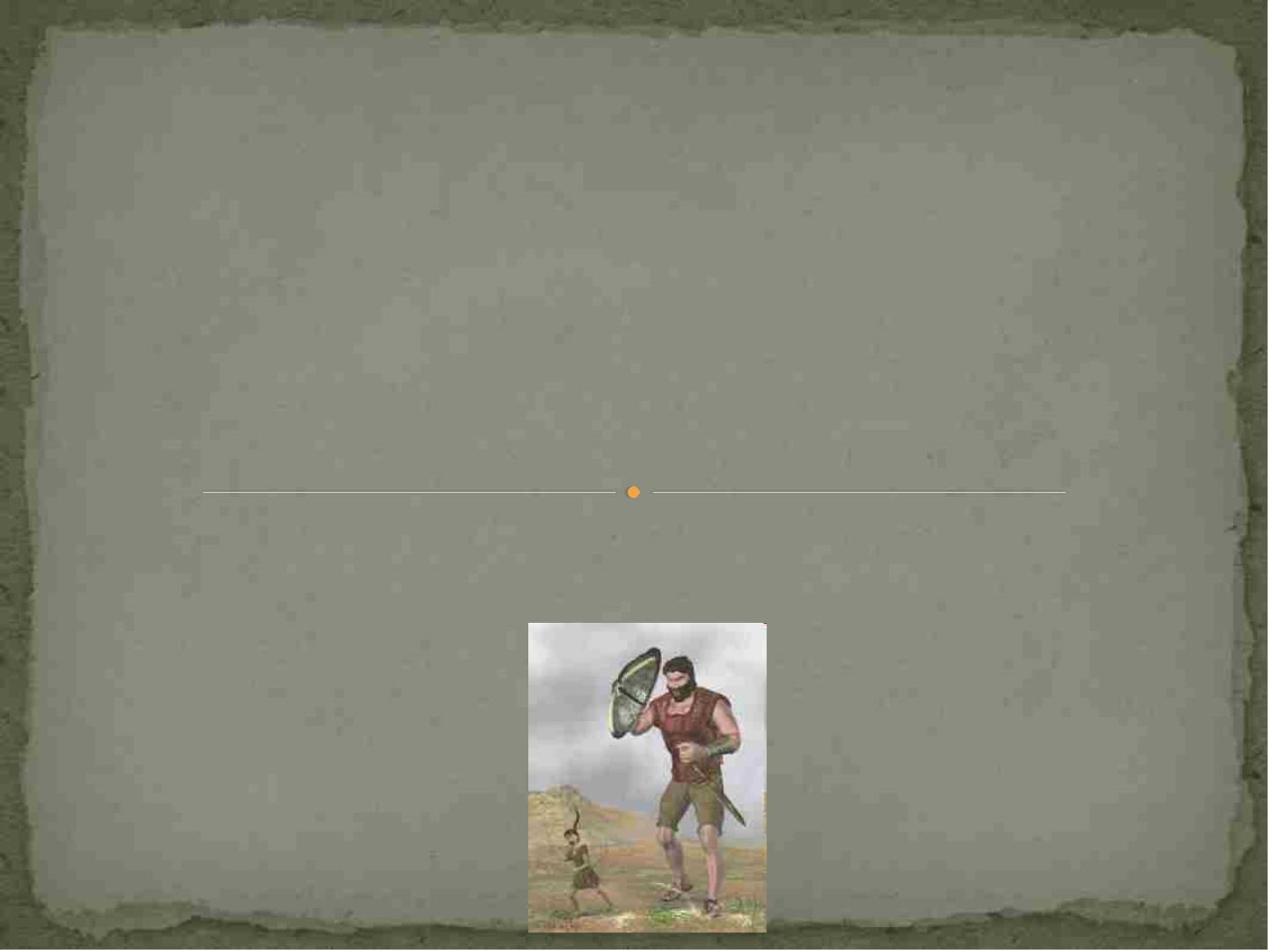
The Immune System and Host
Defense Against Infections
In other words……………….
how to prevent David from killing Goliath
ISHOLA IO Ph.D

Slide 2
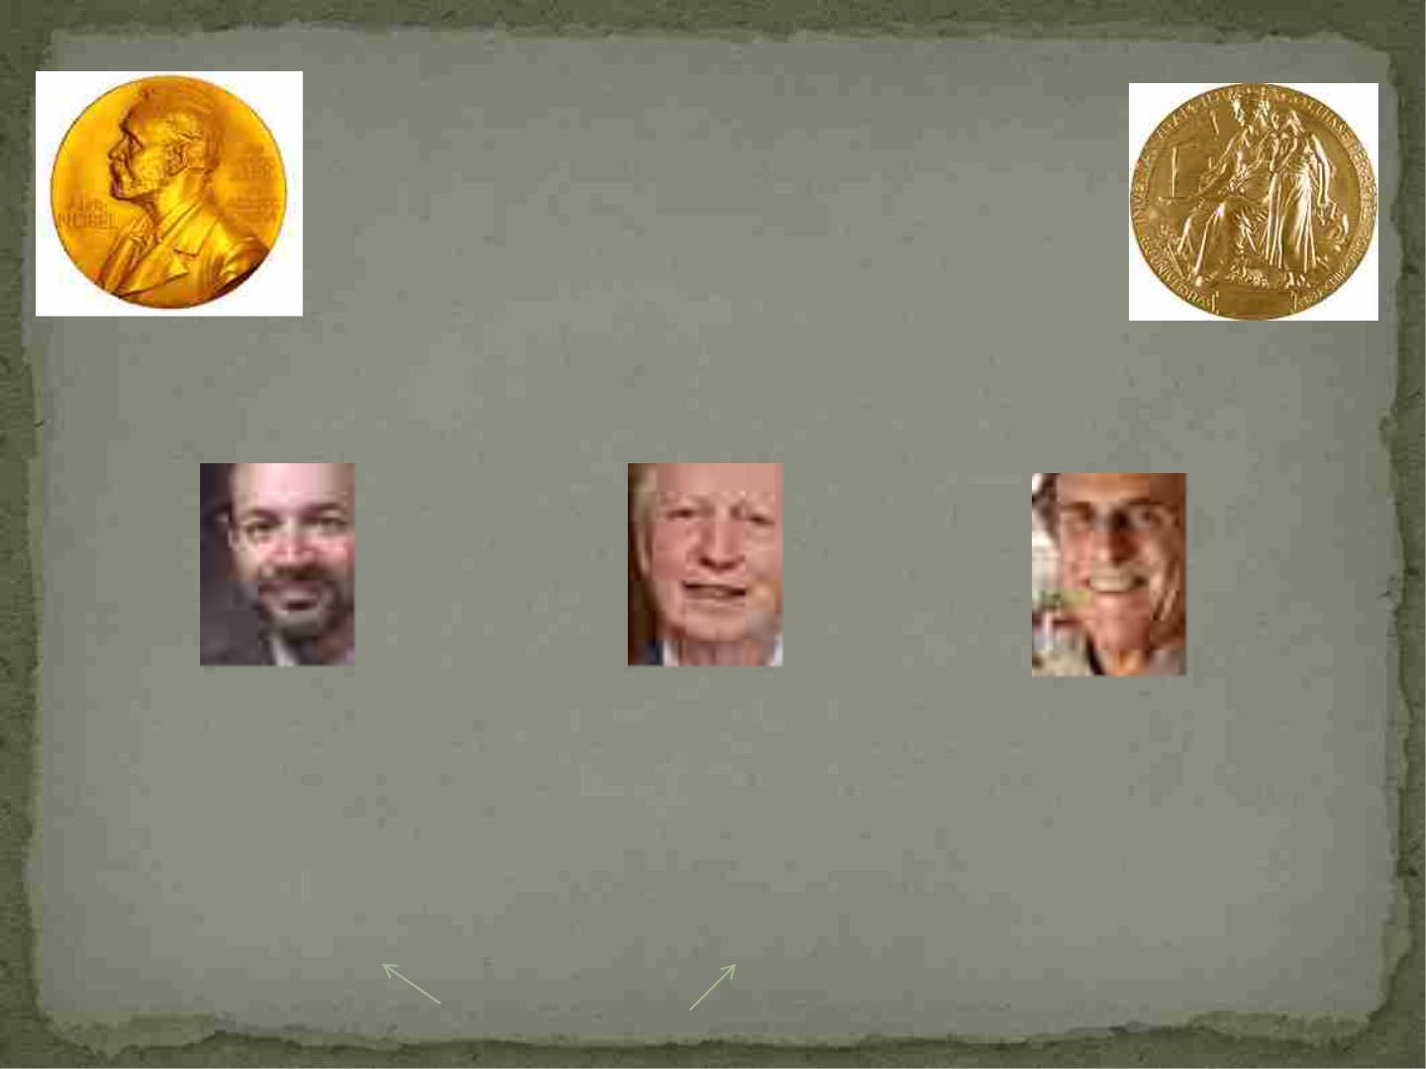
2011 Nobel Prize in Medicine
IMMUNOLOGISTS!!!!!!!
Bruce A. Beutler
Jules A. Hoffman
Ralph M. Steinman
In 1998 Dr. Beutler identified the
cell receptors in mice that
respond to a substance in the coat
of bacteria and that can set off
septic shock if overstimulated.
In 1996, Dr. Hoffmann
discovered the cell receptors
in laboratory fruit flies that
are activated by pathogenic
bacteria or fungi.
In 1973 he discovered the
dendritic cell and worked
for many years defining its
role in adaptive immunity.
Toll Receptors

Slide 3
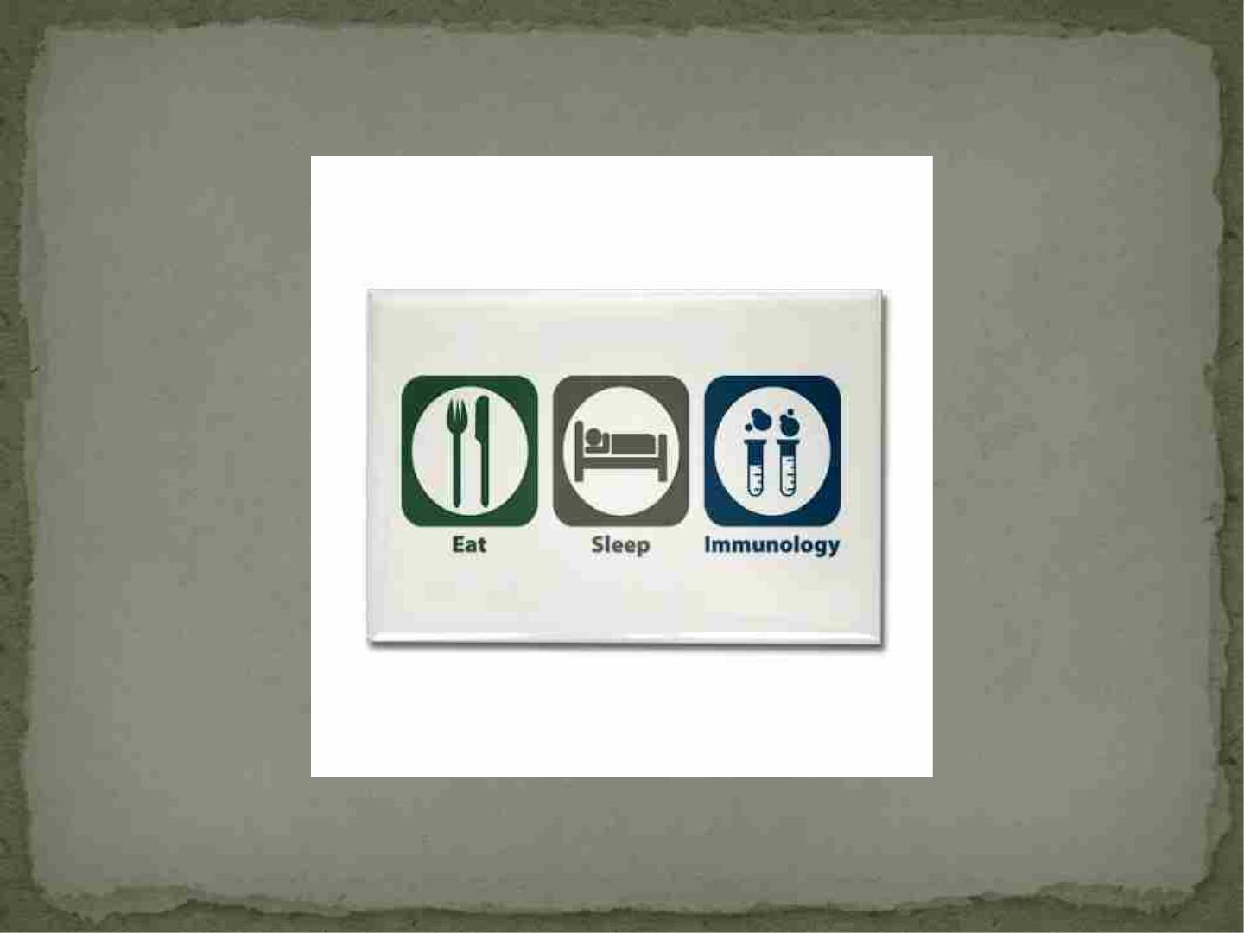

Slide 4

Outline
I. Two arms of the Immune System
A. Innate Immunity
B. Adaptive Immunity
II. Recognition of Pathogens and Effector Mechanisms
III. When things go wrong……

Slide 5
Two Distinct Arms of the Immune System
 Both systems are interrelated
 Innate Immune system= general, attacks pathogens
without specificity (generally speaking)
-designed to act within minutes of the host being
infected
- “innate” refers to the fact that the responses do not
require time to develop, they are ready to go
-use cell receptors that recognize pathogen-associated
molecular patterns (PAMPS)
-most of our encounters with pathogens and toxins
are taken care of by the innate immune system

Slide 6
Cells of the Innate Immune System
 The main cell types are:
-Macrophages
-Dendritic cells
-Natural killer (NK) cells

Slide 7
Two Distinct Arms of the Immune
System
 The Adaptive Immune System=highly specific
 If the innate immune response cannot control and
eliminate pathogens it initiates and mediates the
adaptive immune response
 “adaptive” refers to the fact that it takes time to
produce this response
 Another difference is that once the pathogen is
cleared, the cells involved can form “memory” of the
pathogen
 If the organism is infected again with the same
pathogen, these cells can mobilize more quickly to
defend the host

Slide 8
Cells of the Adaptive Immune System
 The main cell types are:
- T cells
- B cells

Slide 9
Two Distinct Arms of the Immune System
 Pathogens that live in cells are difficult to detect
because of accessibility
-although infected cells may have altered surface
proteins that can be recognized by both the innate
and adaptive response
Innate immune system
-can recognize molecular patterns on the pathogen
itself and an infected cell
-does not depend primarily on recognizing what
pathogen it is

Slide 10
Innate Immune System

Slide 11
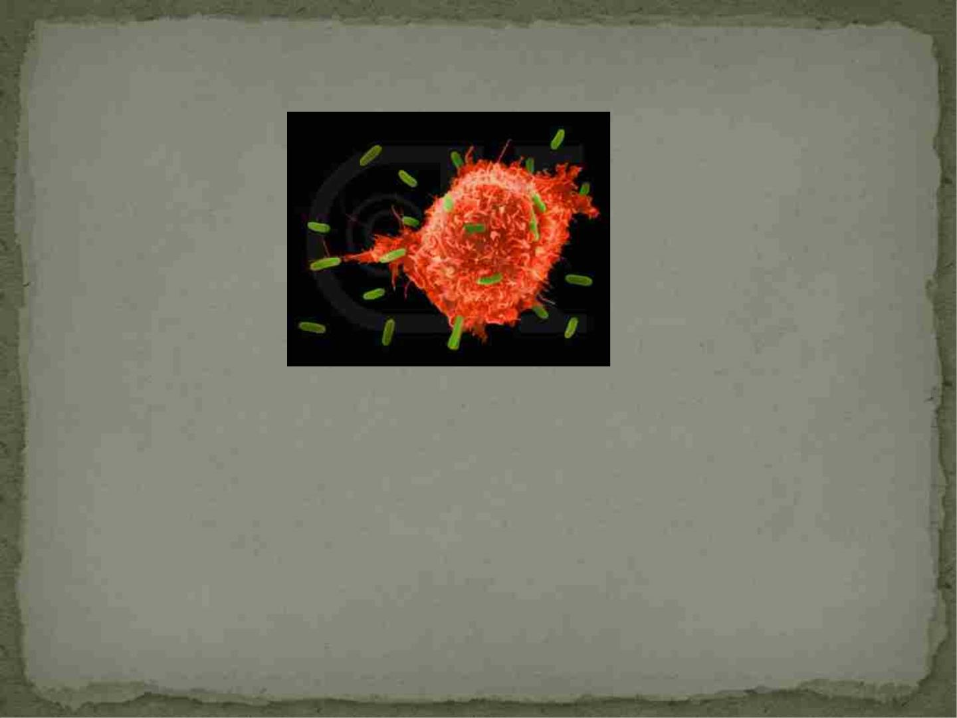
Macrophages
 Macrophage means “large, eating”
 Their function is to ingest and eliminate infectious
agents, process and present antigen (pieces of the
pathogen)
 Help to regulate other immune cells, both innate
and adaptive

Slide 12
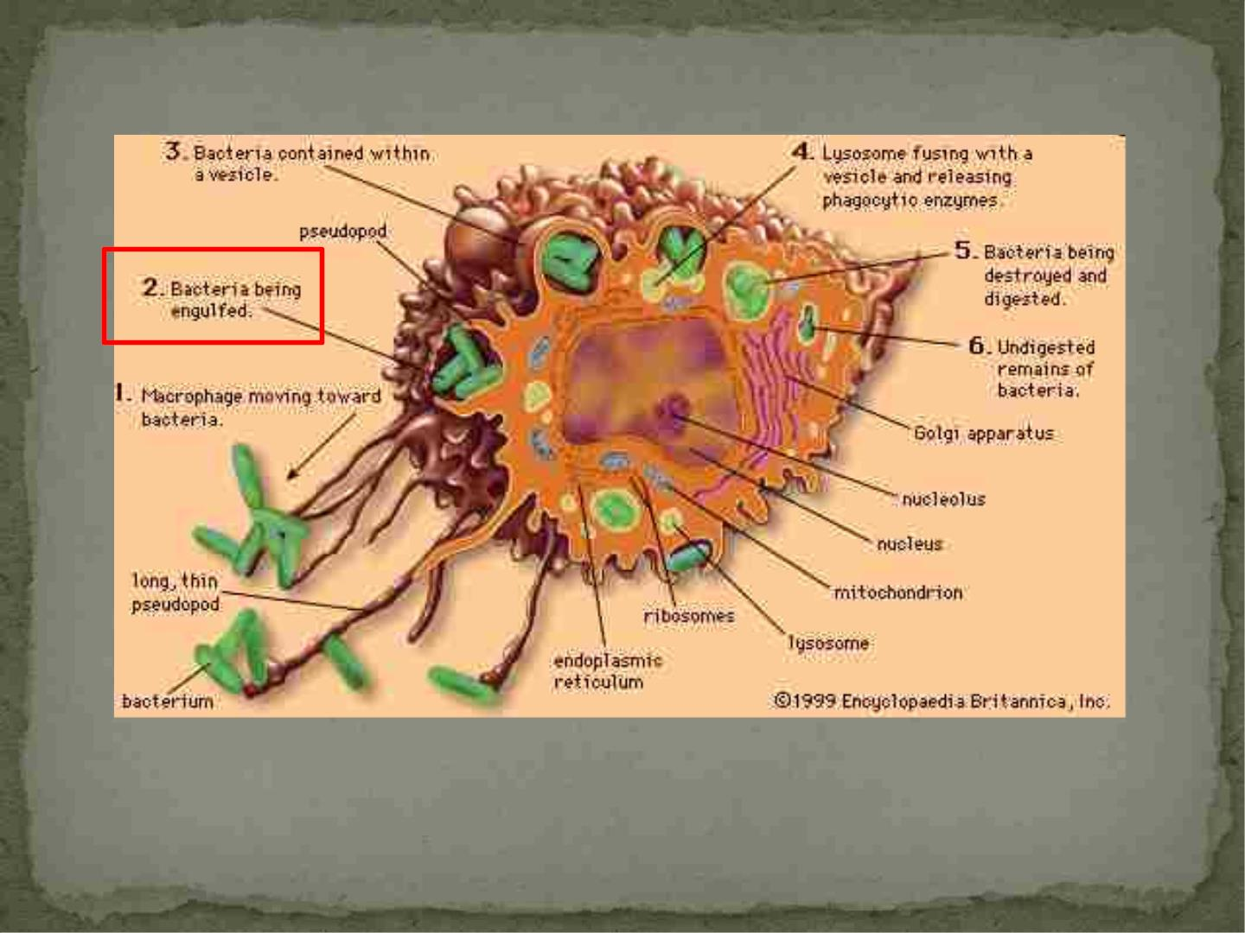

Slide 13
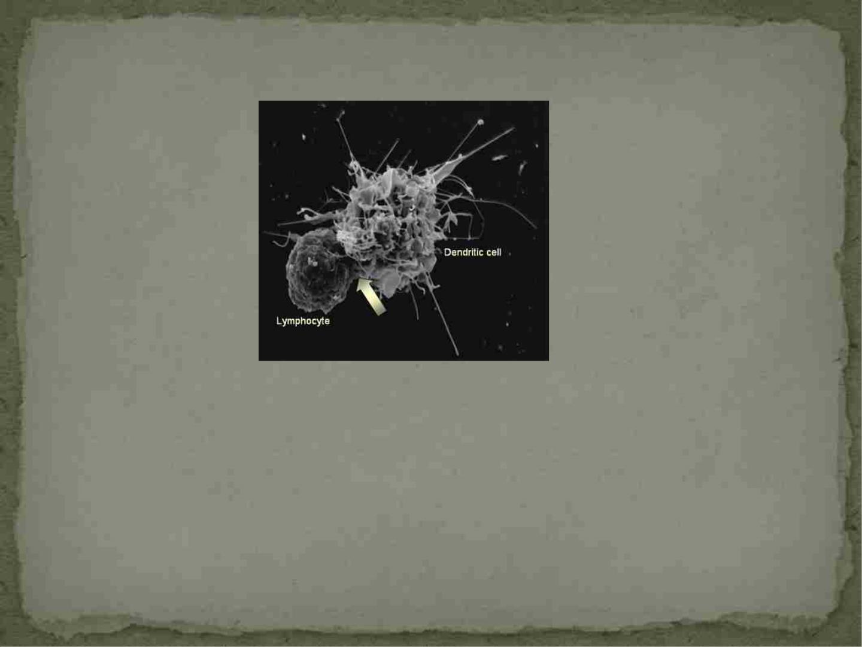
Dendritic Cells
 Have a very characteristic shape with long cytoplasmic processes
(dendrites)
 Reside in tissues in an immature form, mature when an infection or
injury occurs, induce innate response
 Mature DC’s can travel to lymphoid organs (lymph nodes, spleen, etc.)
with antigen on their surface and act as antigen-presenting cells
(APC), very effective
 Also influence activated T-cells

Slide 14
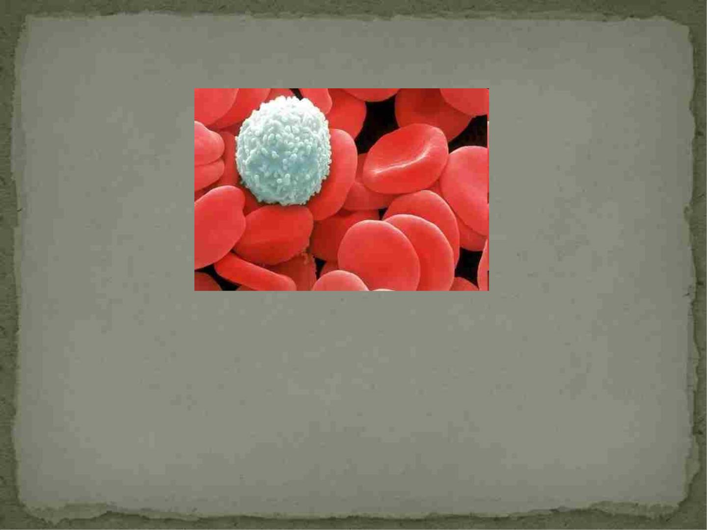
Natural Killer (NK) Cells
 Responsible for background in experiments testing
the ability of lymphocytes to kill specific target cells
 Large granular lymphocytes that do not need to be
induced or primed to kill cells

Slide 15
Adaptive Immune System

Slide 16
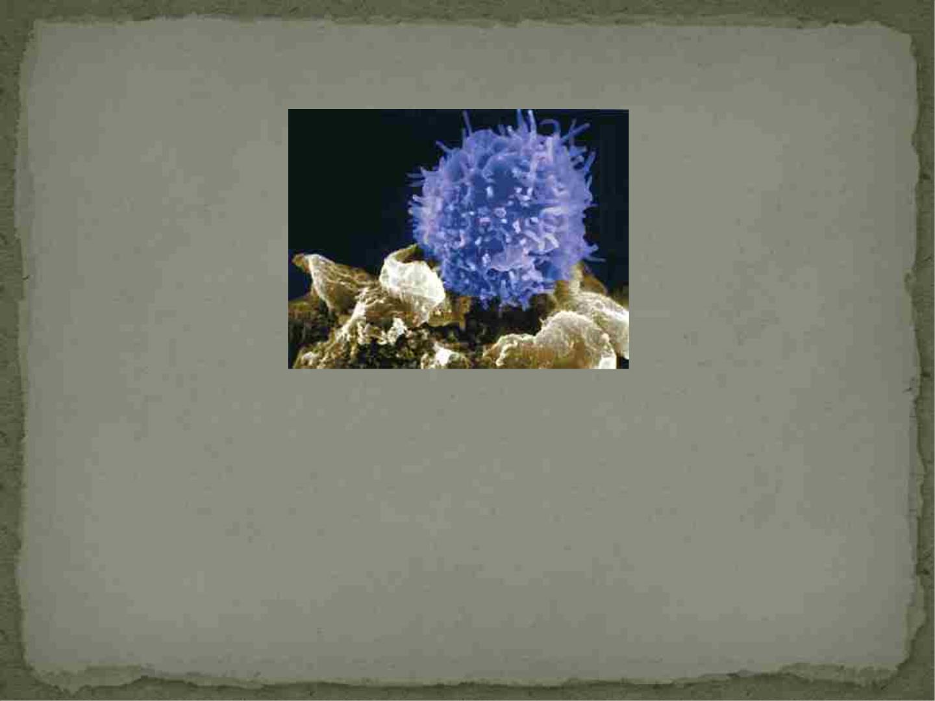
T cells
Topnews.in
 “T”-cells mature in the thymus
 Two main phenotypic types of T-cells: CD4+ T cells
(T helper cells) and CD8+ T cells (cytotoxic T cells)
 Responsible for specific recognition of antigens and
can retain “memory” of an antigen

Slide 17
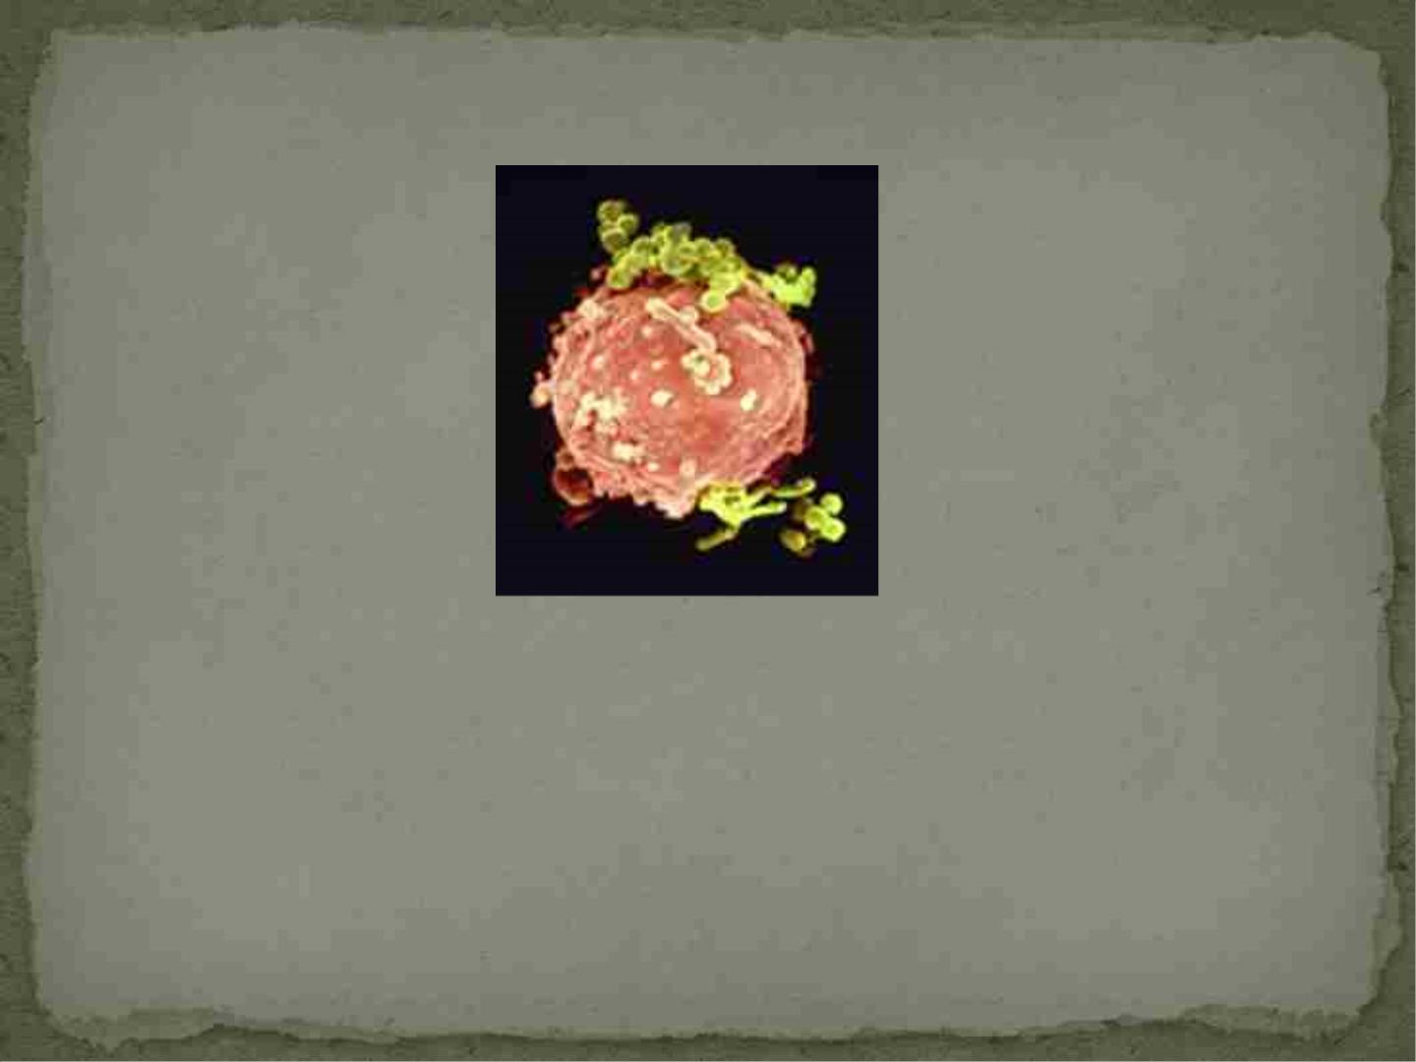
B cells
Photo: Lennart Nilsson copyright,
Material: Anders Rosén
 Mature in the bone marrow
 Produce specific antibodies against invading
organisms
 Can differentiate into plasma cells (produce antibody)
and retain “memory” of the antigen encounter

Slide 18
Three Defining Characteristics of the Immune
System
 It can discriminate between self and non-self
-between host and non-host
 It remembers what it has encountered (memory)
-allows the immune system to react more quickly and
effectively to previous pathogens
-basis for vaccination
 Responds only to the pathogen at hand (specificity)

Slide 19

How does the immune system
achieve these three goals??

Slide 20
Recognition of Pathogens

Slide 21
Antigen
 Substances from a pathogen that can trigger an
immune response
 Epitopes: small subregions on the antigen that are
recognized by receptors on immune cells
-also known asantigenic determinants
-one antigen can have many epitopes that can be
recognized
-can be amino acids, sugars, lipids, or nucleotides
 Adaptive immunity=recognize highly unique epitopes
-T-cell specific for an epitope of gp150 in HIV
 Innate immunity= recognize antigens that are not
species specific, antigens that are common in a class
of microorganism (bacteria, viruses, parasites, etc.)

Slide 22
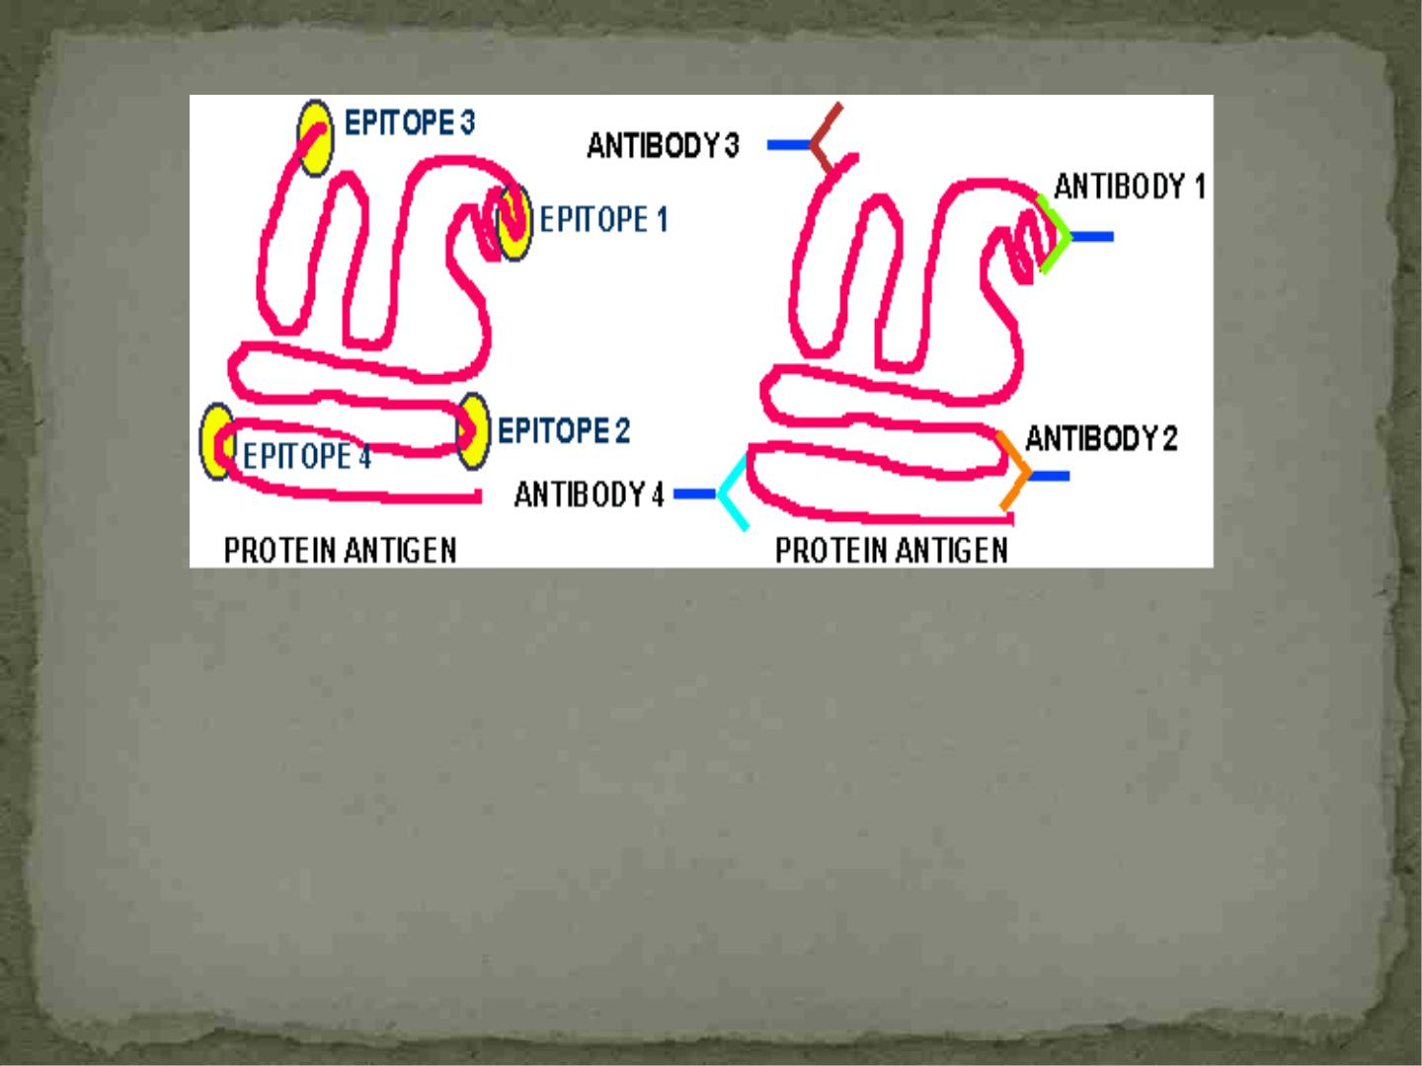
-Much work is directed at elucidating the nature of
antigens and what elicits a good immune response
-used to design vaccines and other therapeutics to combat
infectious organisms
-the H1N1 vaccine, Influenza vaccine

Slide 23
Antigen Recognition-Adaptive
Immunity
 B and T lymphocytes
 Have surface proteins that recognize only one antigen
-very very specific
-surface proteins are calledantigen receptors
- it is the antigen receptors that are responsible for the
specificity
- T-cell: one small peptide
- B cell: usually more than just a small peptide needed
 Once the antigen binds the receptor, B or T-cell
becomes activated and this triggers an immune
response.

Slide 24
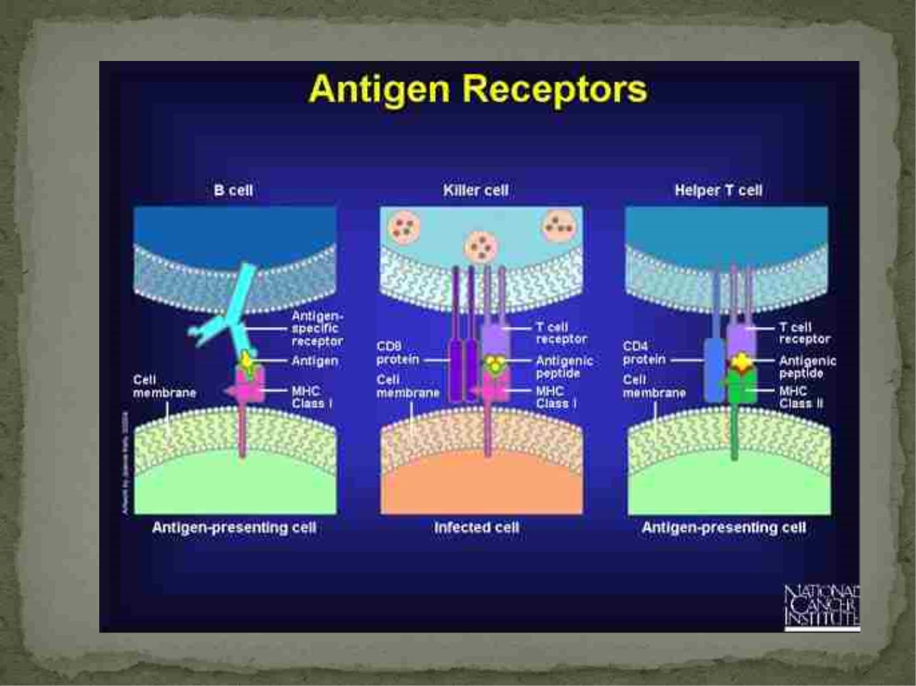
CD8+ T-cell
CD4^{+ T-cell}

Slide 25
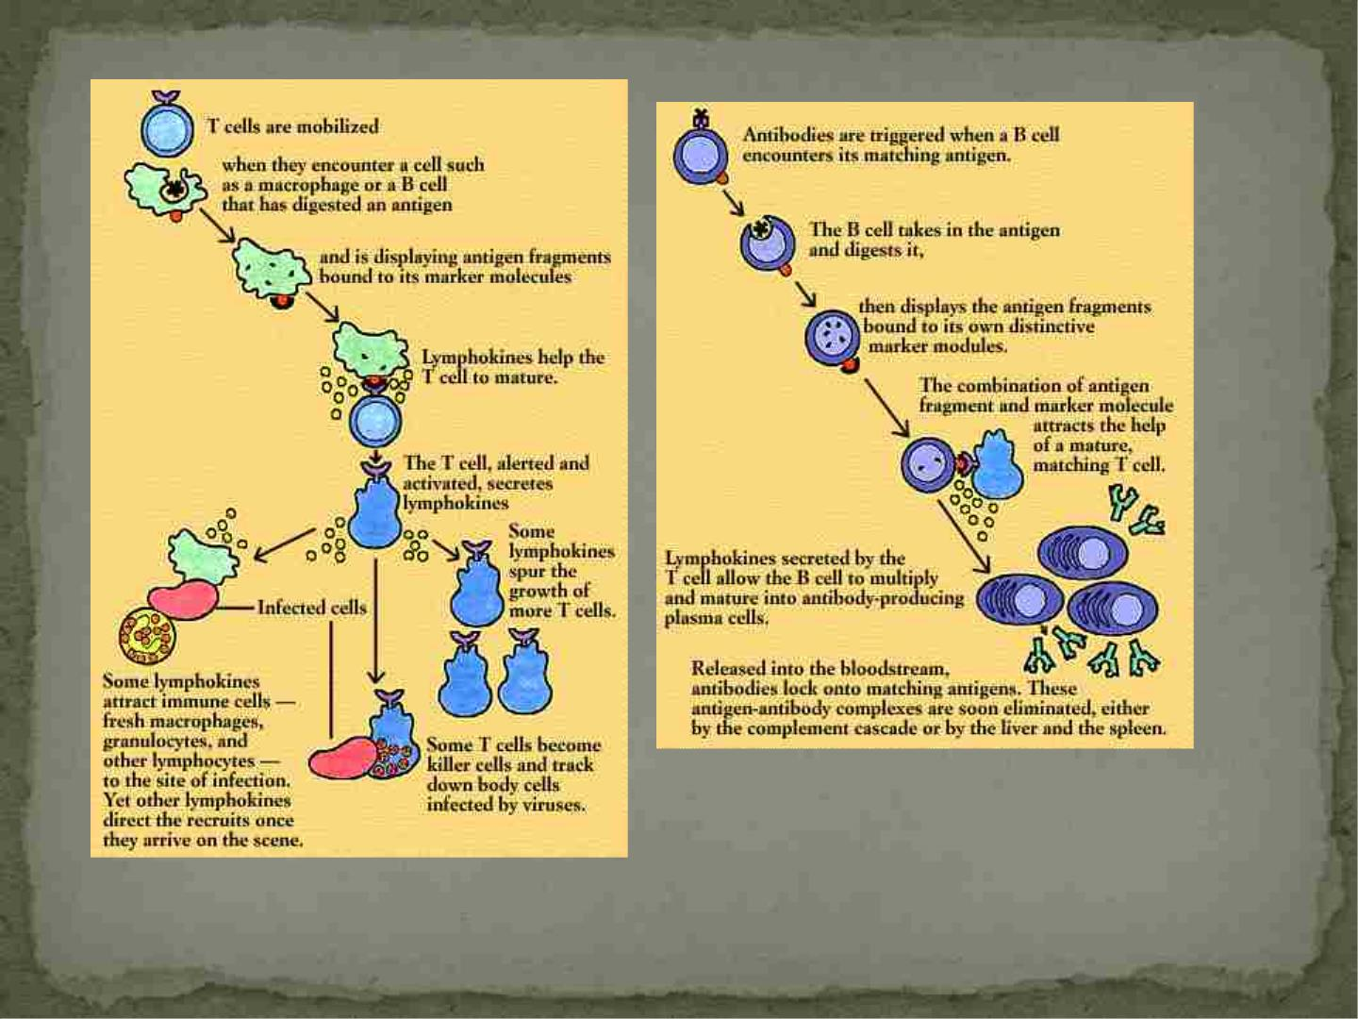
http://thyroid.about.com/library/immune/blimm13.htm

Slide 26
How is the specificity of the receptors
created????
 Both B and T cell receptors have the ability to
recognize any antigen that is encountered
-true for synthetic ones also
 Problem that puzzled scientists for YEARS!!!
 Why?? Because there is not enough DNA in a cell to
encode one gene for each possible antibody
 The answer: combine conserved areas of the receptor
(only need a few genes) with highly variable gene
segments created by recombining DNA, DNA
mutations, etc..

Slide 27
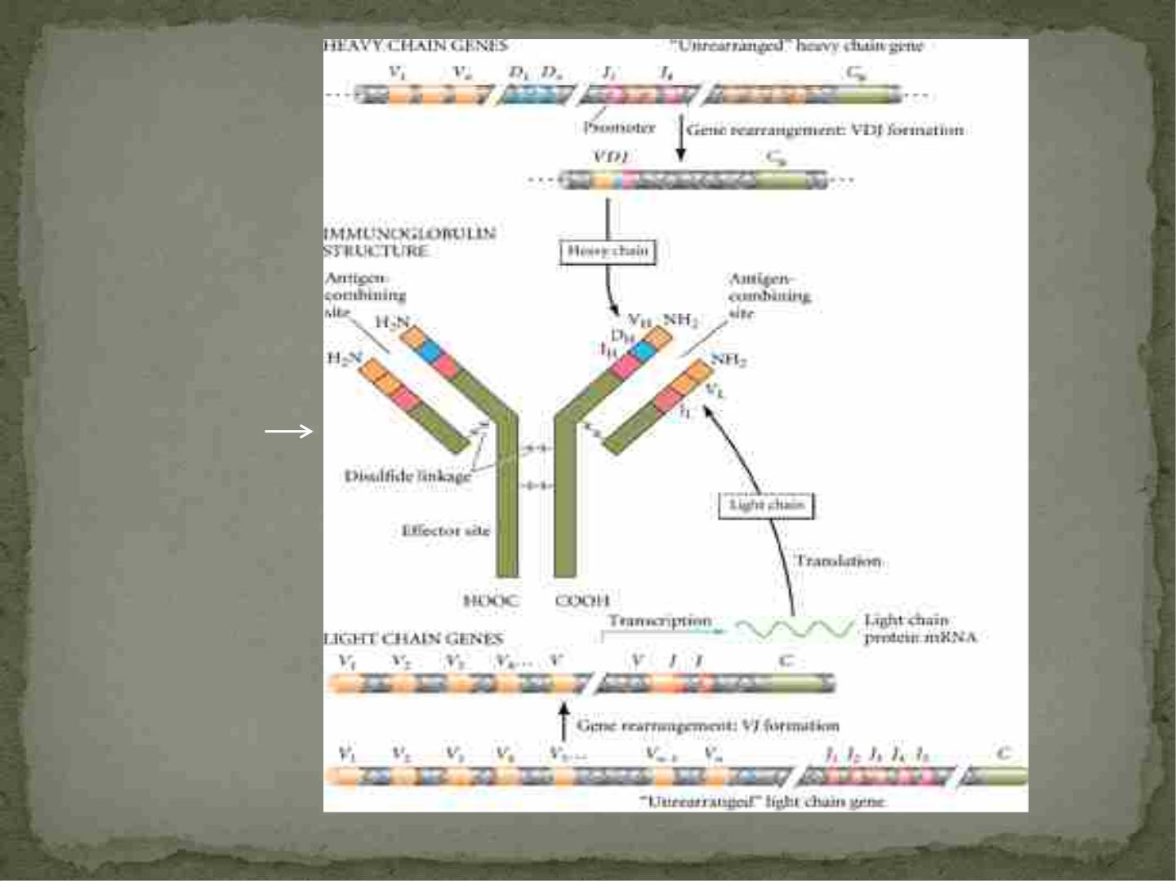
antibody
http://flipper.diff.org/app/items/info/1052

Slide 28
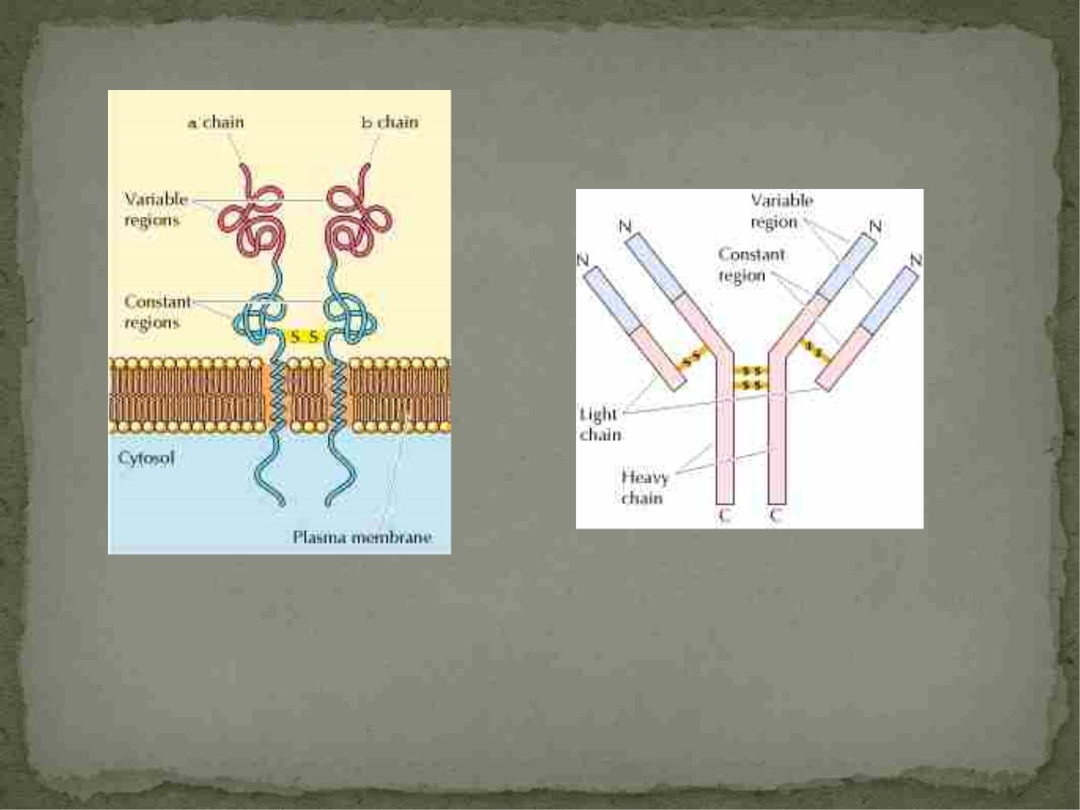
T-cell receptor
Antibody
Copyright © 2000, Geoffrey M Cooper
http://www.ncbi.nlm.nih.gov/bookshelf/br.fcgi?book=cooper&part=A
828
-It is the variable region that determines the specificity of the receptor
-Estimates of the different T-cell and B-cell receptors using various means
of recombining are 10¹⁸!!!!

Slide 29
Differences Between T-cell and B-cell
Receptors
 B-cell receptor:
-recognize antigen in native form (as they exist in
nature)
-does not need help from other cells to recognize the
antigen
-true whether or not the antibody is on the surface
(receptor) or if it has been secreted from the cell

Slide 30
Differences Between T-cell and B-cell Receptors
 T-cell receptor:
-CANNOT recognize native antigen
-can only recognize antigen that has been broken down
into epitope sized peptide fragments
-antigen has to go throughantigen processing
-recognizes the peptide and a surface protein on the cell that
carries the peptide
-surface proteins are called major histocompatibility
complex (MHC) proteins
-MHC presents the peptide to the T-cell receptor in a
process called antigen presentation
-T-cells only recognize peptides in the presence of MHC
-Antigen recognition by T-cells is said to be MHC
restricted
and T cells must behistocompatible to be activated

Slide 31
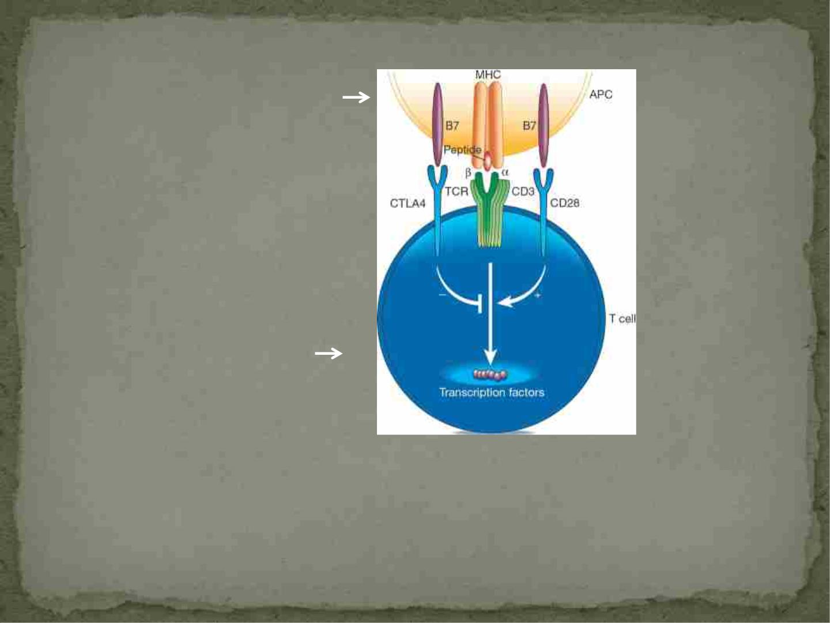
Antigen presenting cell
(APC)
Macrophages, Dendritic cells,
B cells
T-cell
Appelbaum, et al. Nature 2001

Slide 32
MHC Proteins
 Highly variable from person to person, most variable
proteins known
 Variability is what allows the immune system to
distinguish self from non-self
 MHC Class I- expressed on all nucleated cells
 MHC Class II-primarily expressed by immune cells
-macrophages, dendritic cells, B cells and T cells
 In humans MHC are also called human leukocyte
antigens (HLA)
-used to type individuals for bone marrow and organ
transplants

Slide 33
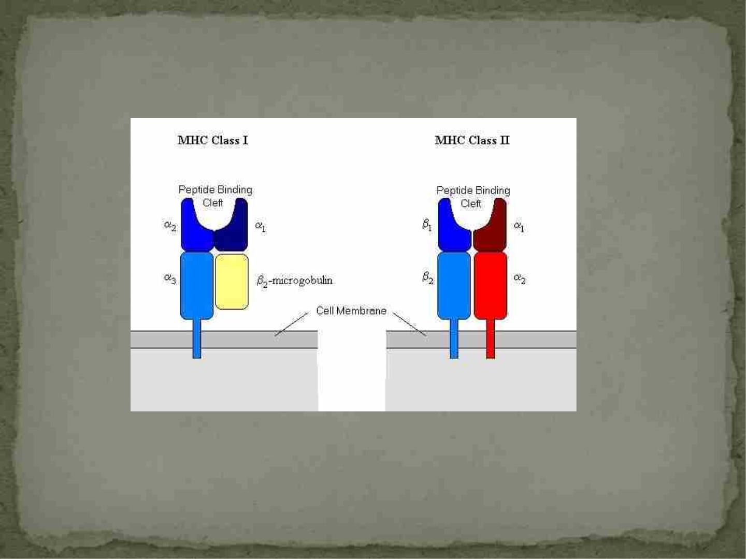

Slide 34
MHC Proteins
 There are more than 2100 distinct MHC sequences
 MHC proteins contain indentations or clefts that can
accommodate small peptides (8-11 aa for MHC I and 13
-17 aa for MHC II)
-the peptides that make up the cleft determine which
antigen peptides can bind there
 Each person inherits one set of class I (A, B, C)and
one set of class II (HLA-DR, -DQ and –DP) from each
parent
-end up with 6 MHC class I and 6 MHC class II
receptors that are expressed equally

Slide 35
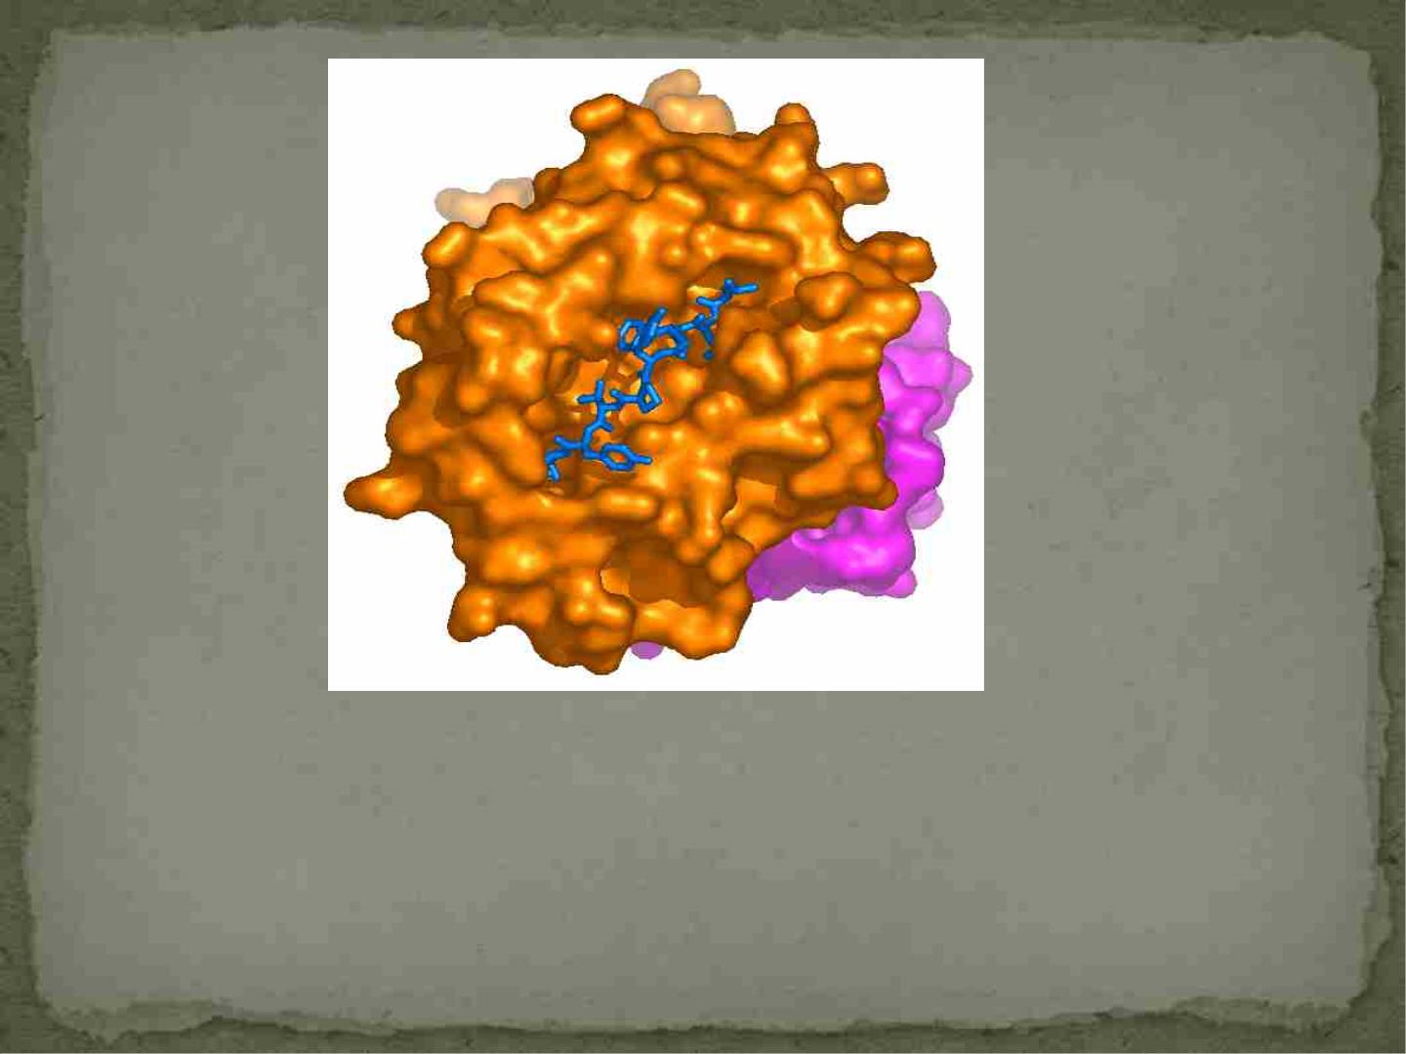
(February 2003, www3.ebi.ac.uk/Services/imgt/hla/cgi-
bin/statistics.cgi).
-Peptide binding in the pocket of a MHC-I molecule

Slide 36
MHC Proteins
 MHC class I proteins are primary ones responsible for
graft rejection
-must be expressed by target cell to be killed by an
antigen-specific CD8+ T cell
 MHC class II- all of the “professional” antigen
presenting cells express it
-macrophages, B cells, dendritic cells

Slide 37
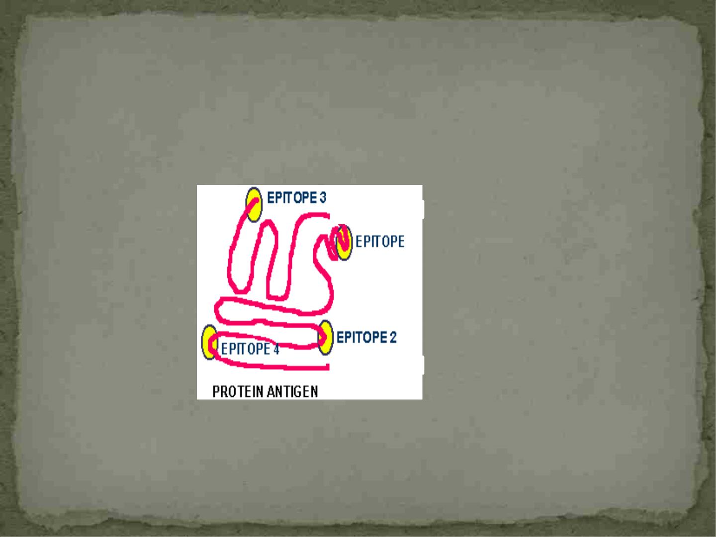
 Because of the huge variety, MHC from one individual will
interact differently with antigen than another individual
 A protein from a pathogen contains epitopes A, B, C, D
-A person may only present epitope A because of their
MHC type and another person may only present epitope B
A
B
C
D
-Makes it very challenging to immunize T cells in a human population versus B
cells (recognize native antigen which is the same for everyone)
-Almost all successful vaccines that have been generated depend on B-cell
responses rather than T-cell responses

Slide 38
Interesting Facts About MHC Alleles
 MHC B57 and B27 are associated with better
outcomes in HIV infection
 MHC B35 associated with faster decline of HIV
infected individuals
 MHC HLA-DRB1*091 is associated with better control
of Dengue Virus, MHC A*24 is detrimental

Slide 39

Interesting Facts About MHC Alleles
 When women are given a selection of men’s sweaty t-
shirts and asked which smells the most attractive to
them, they pick t-shirts from men whose MHC set is
most different from their own
-kid’s MHC set are more diverse
-women on birth control pill can’t discriminate

Slide 40
Antigen Recognition-Innate Immunity
 Natural Killer (NK) cells play a big role in triggering
innate immunity
-do not have antigen receptors
-have surface receptors that inhibit killing function
-killer inhibitory receptors (KIRs)
-recognize abnormal levels of MHC class I
-if a cell has normal amount of MHC class I then
NK cells do not kill it
-if MHC class I is in lower amounts (some
virally infected cells and tumor cells do this) it
will be killed

Slide 41
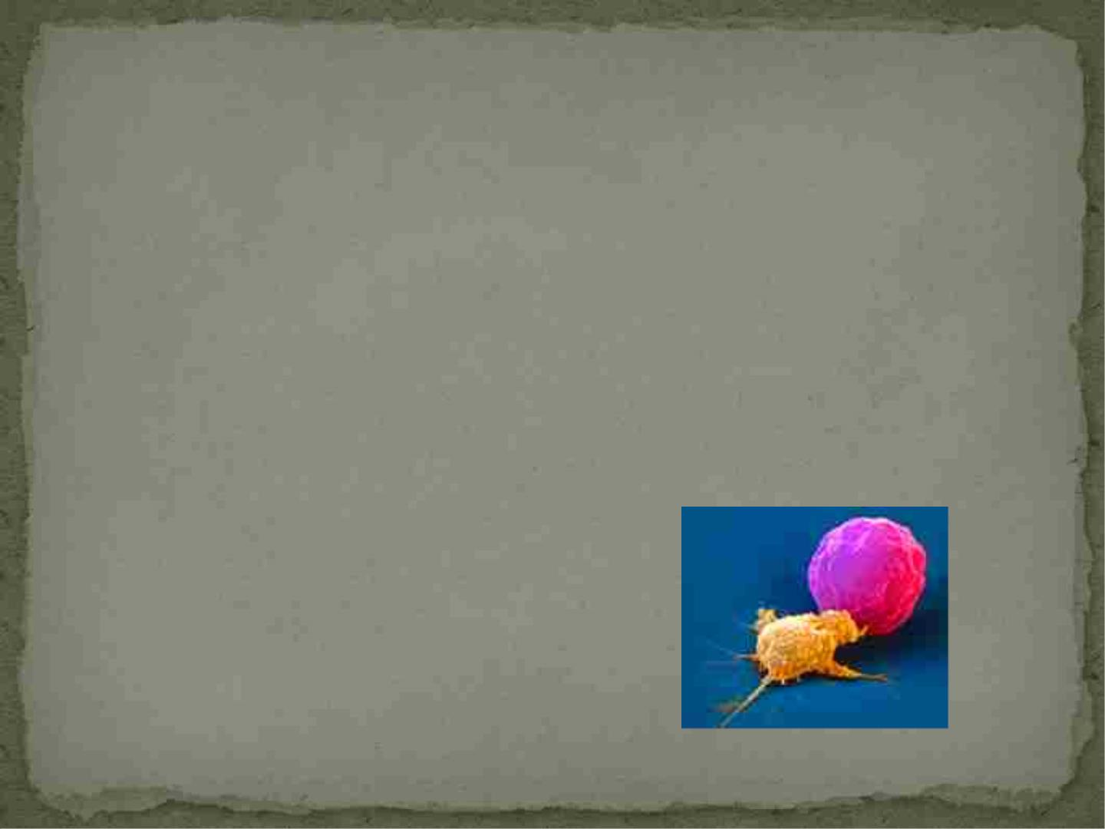
 Many viruses interfere with the expression of MHC by
the host cell
-most likely to avoid killing by CD8+ T-cells which use
MHC class I to kill cells
-NK cells are very important for catching these
infected cells
-Recently there is evidence that NK cells are helpful in
killing cells that over express MHC class I (pre-cancer
cells)
NK cell (yellow) killing a cancer cell (purple)
http://www.nhs.uk/news/2009/09September/Pages/MasterKillerGenes.aspx

Slide 42
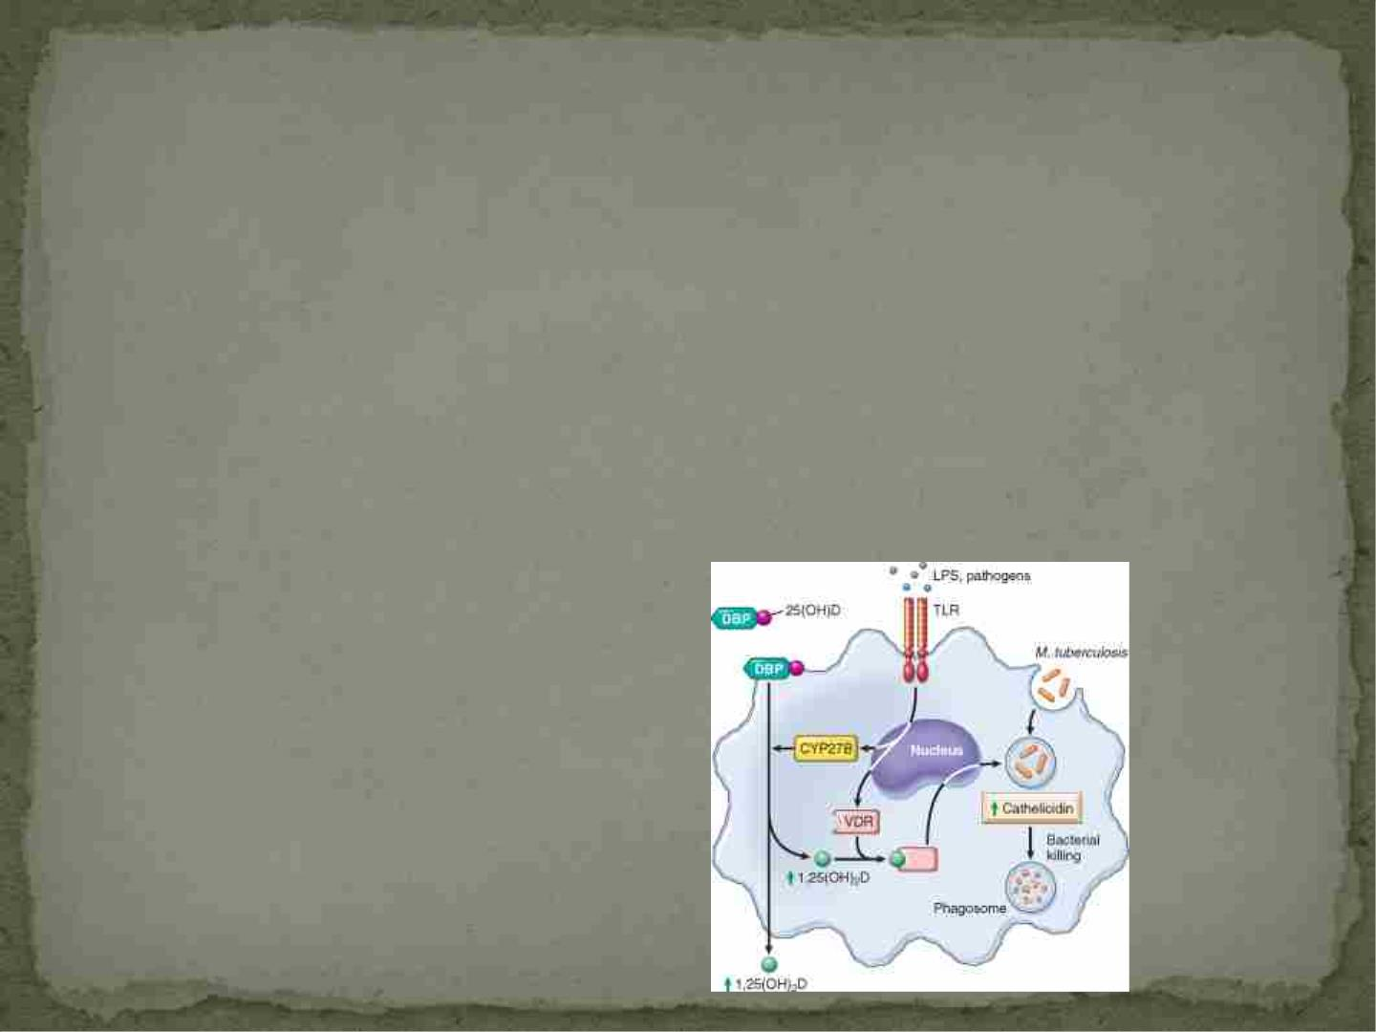
Other Innate Cells……
 Dendritic cells and Macrophages recognize molecules
that are common to groups of pathogens
-antigen receptors are calledpattern recognition
receptors (toll-like receptors)
-examples of these molecules are carbohydrates and
lipopolysaccharides, GpC motifs in bacterial DNA (are
not in mammalian DNA)
Kumar: Robbins and Cotran Pathologic Basis of
Disease, Professional Edition , 8th ed.
Copyright © 2009 Saunders, An Imprint of Elsevier

Slide 43
What happens after the antigen
is recognized????

Slide 44
Immune Activation and Effector
Mechanisms

Slide 45
Immune Activation
 Lymphocytes generally exist in the blood in a “resting”
state
 Allows the immune system to send cells where they
need to go when a trigger occurs
 Uncontrolled immune responses can cause damage to
the host
-need to limit activation and shut it off as quickly as
possible

Slide 46
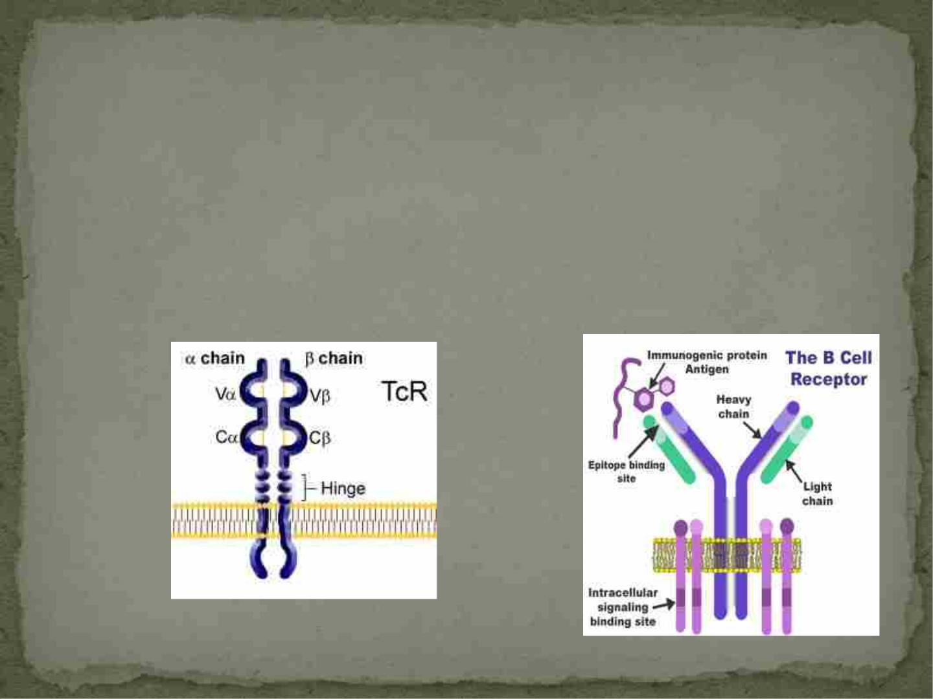
Immune Activation-Adaptive Immune
System
 T- and B-cell receptors are anchored in the cell membrane
 When the antigen receptor binds antigen then the associated
molecules are altered to activate the lymphocyte
http://bioweb.wku.edu/courses/biol328/TcR.htm
http://www.arthritis.co.za/immunologyupdate.html

Slide 47
Immune Activation-Adaptive Immune
System
 The ability of anextracellular antigen to cause
activation of intracellular processes across the cell
membrane requires signal transduction
 Usually need more than one signal to do this
 Second signal is not antigen specific

Slide 48
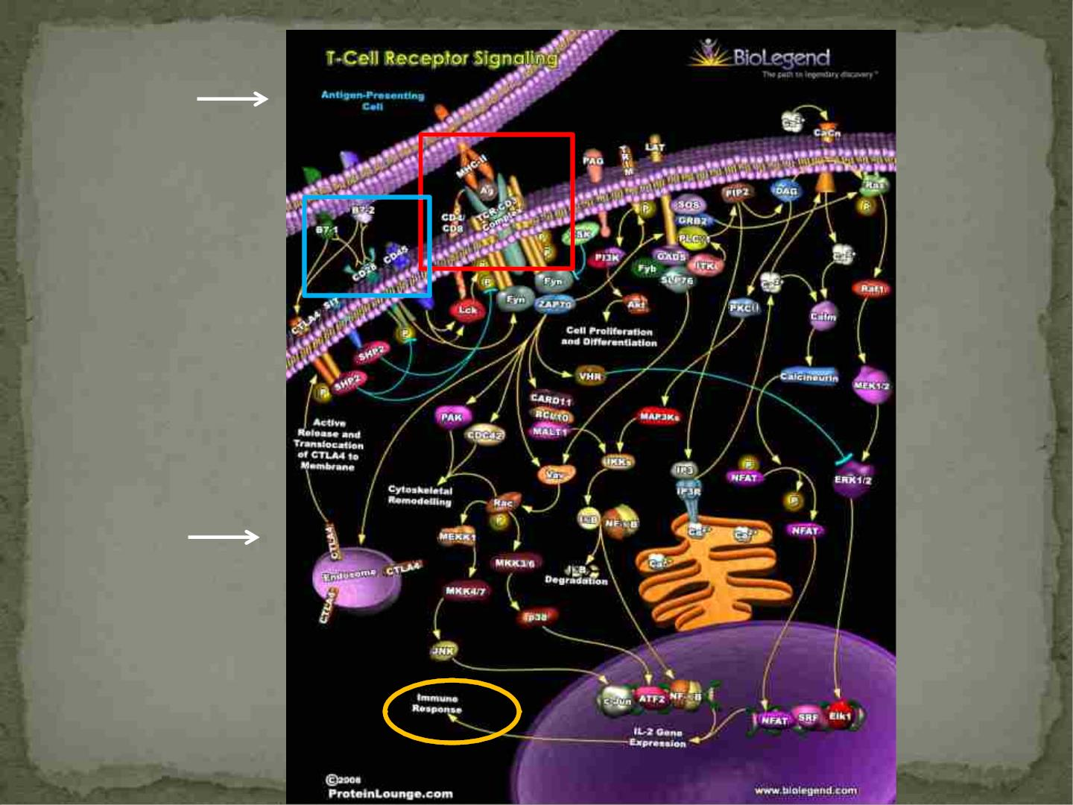
APC
T cell

Slide 49
Immune Activation-Adaptive Immune
System
 B and T cells that have been activated then undergo
cell division
 Give rise to aclonal expansion of just the cells specific
to that antigen
 Called clonal selection and is important for immune
control of the reaction

Slide 50
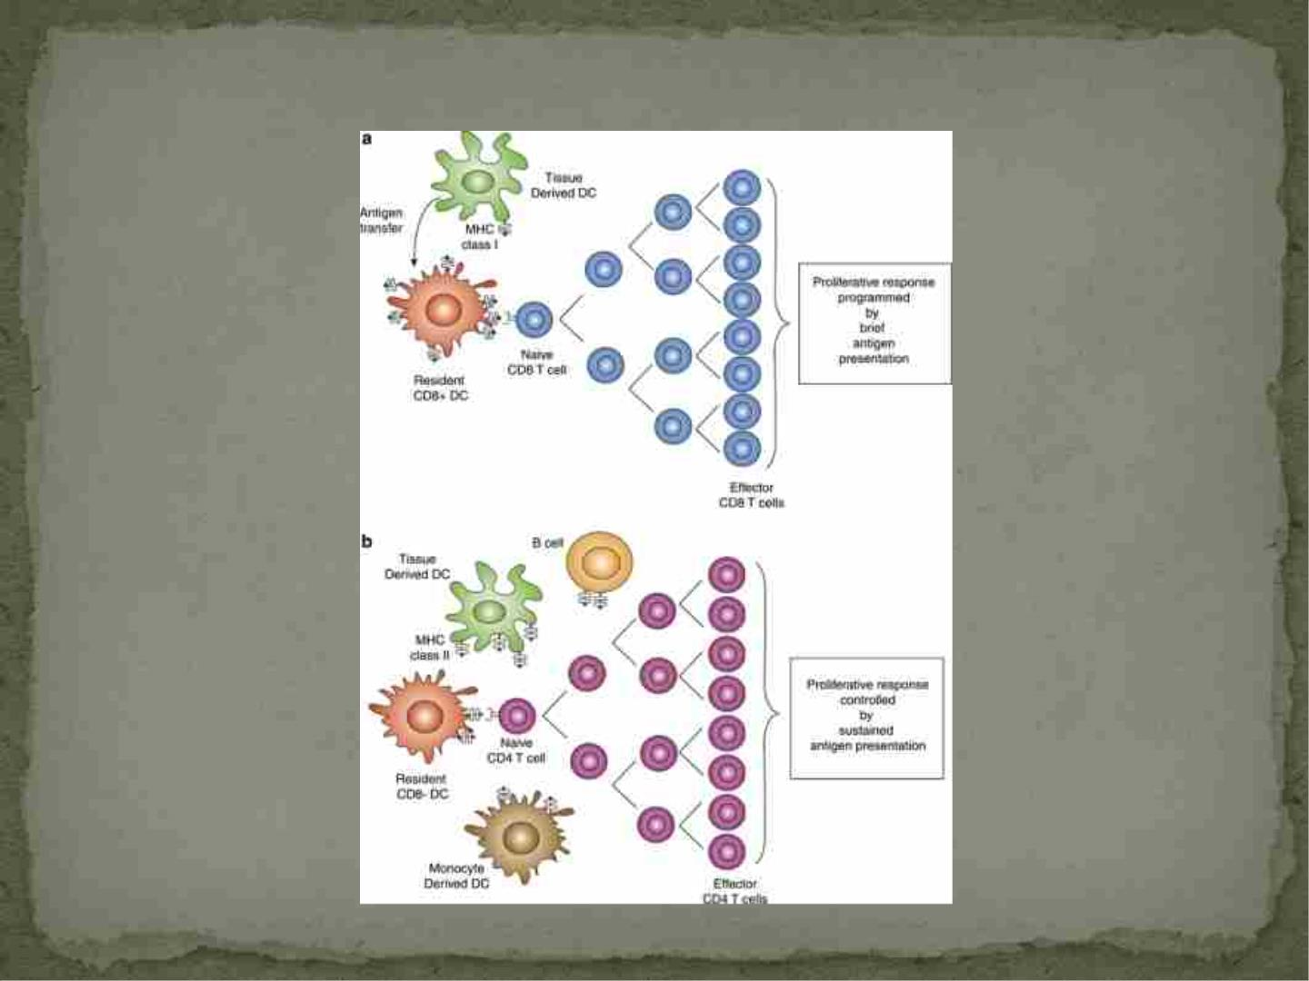
T cell clonal expansion
© 2012 Australian Society for Immunology

Slide 51
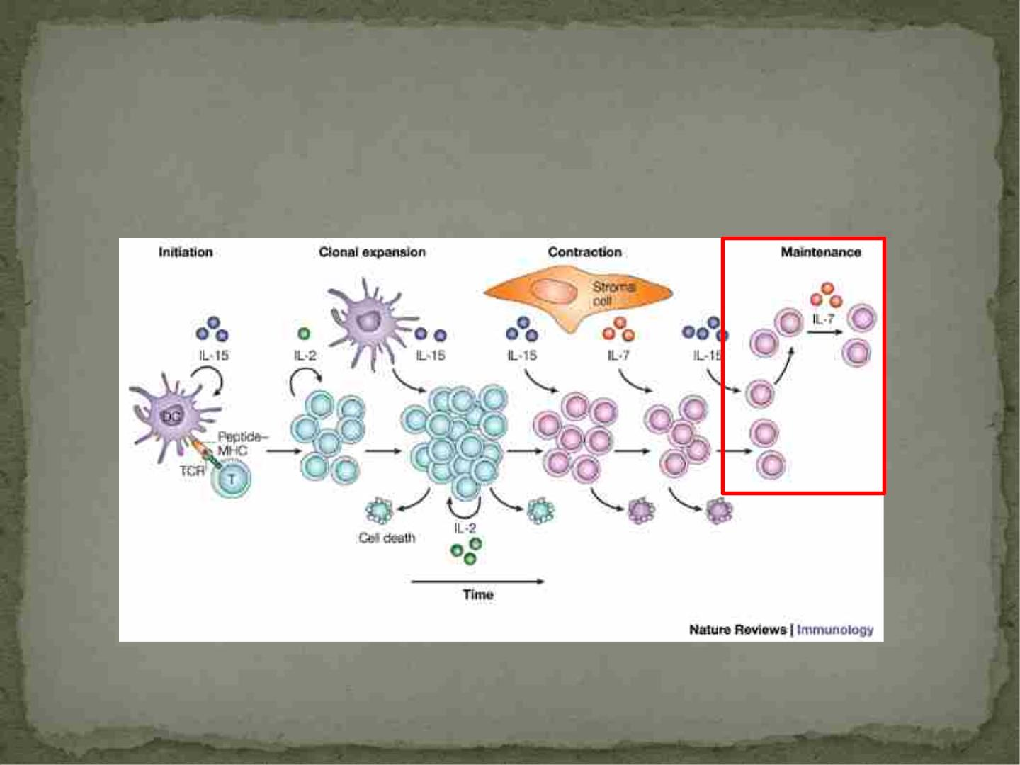
T cell clonal expansion
Memory cells
Schluns , et al. 2003

Slide 52
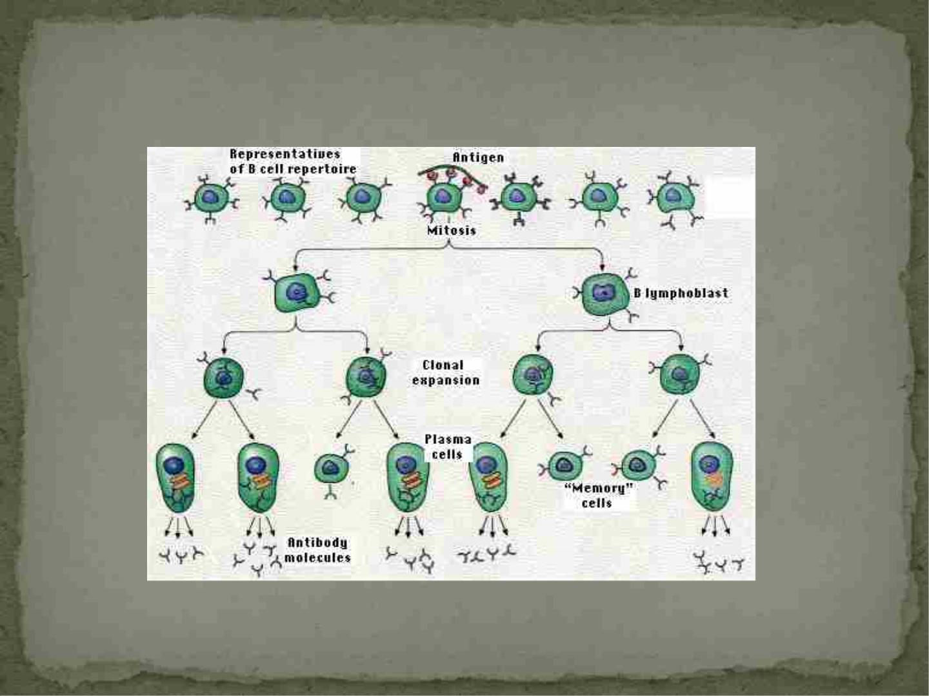
B cell clonal expansion
http://users.rcn.com/jkimball.ma.ultranet/BiologyPages/C/ClonalSelection.html

Slide 53
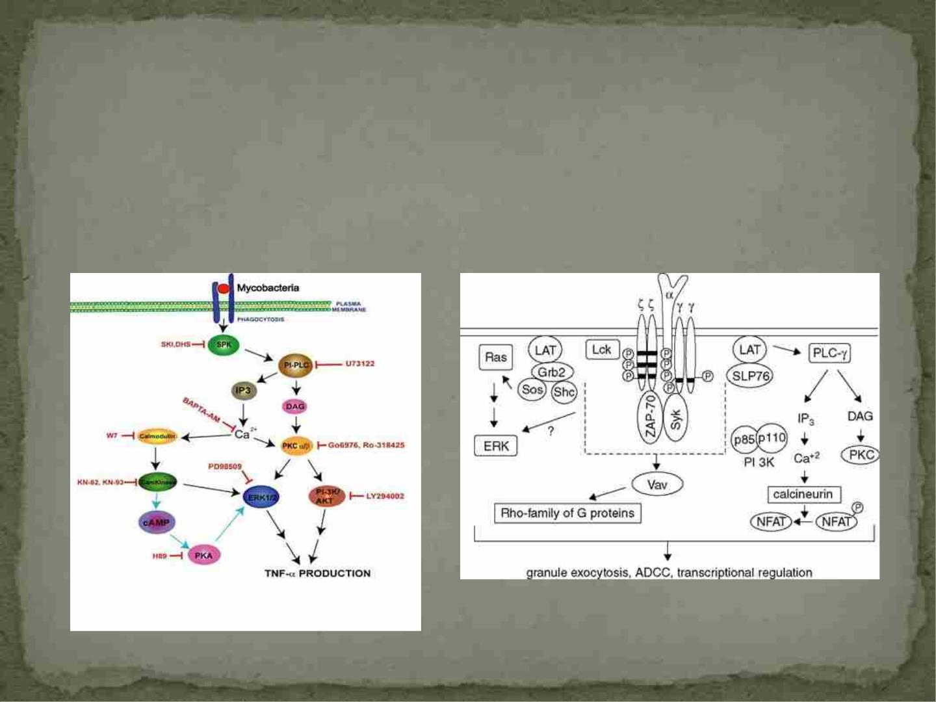
Immune Activation-Innate Immunity
 Very similar to T-cell receptor activation
Macrophage signaling
NK cell signaling
Current Protocols in Cytometry, 2001
http://biology.nd.edu/people/faculty/schorey/

Slide 54
Immune Effector Mechanisms
 Chain of Events:
1. Pathogen enters the host
2. Innate immune system is first line of defense
-fills lag time and tries lessen pathogen’s strength
3. Adaptive immune response is second
-can take several days in anaïve host
-low number of specific cells, need to activate and
expand

Slide 55
Basic Effector Mechanisms
 Adaptive Immune Response:
-antibody production
-activating immune cells and getting them ready to
directly or indirectly kill organisms
-actually killing the appropriate cells or organisms
-regulate all of these functions
 All done by specific cells with the control of specific
cytokines
 Innate Immune Response: also controlled by
cytokines

Slide 56
Cytokines
 Small proteins that are similar in function to hormones
 Control cellular functions over a small distance, in close
proximity to the cell that secreted it-paracrine regulation
-activated helper T cell secretes a cytokine to help
the B cell nearby differentiate into an antibody-
secreting cell
 Can also act on the cell that secreted it- autocrine
regulation
-activated T helper cell secretes a cytokine that
helps it to proliferate and clonally expand

Slide 57
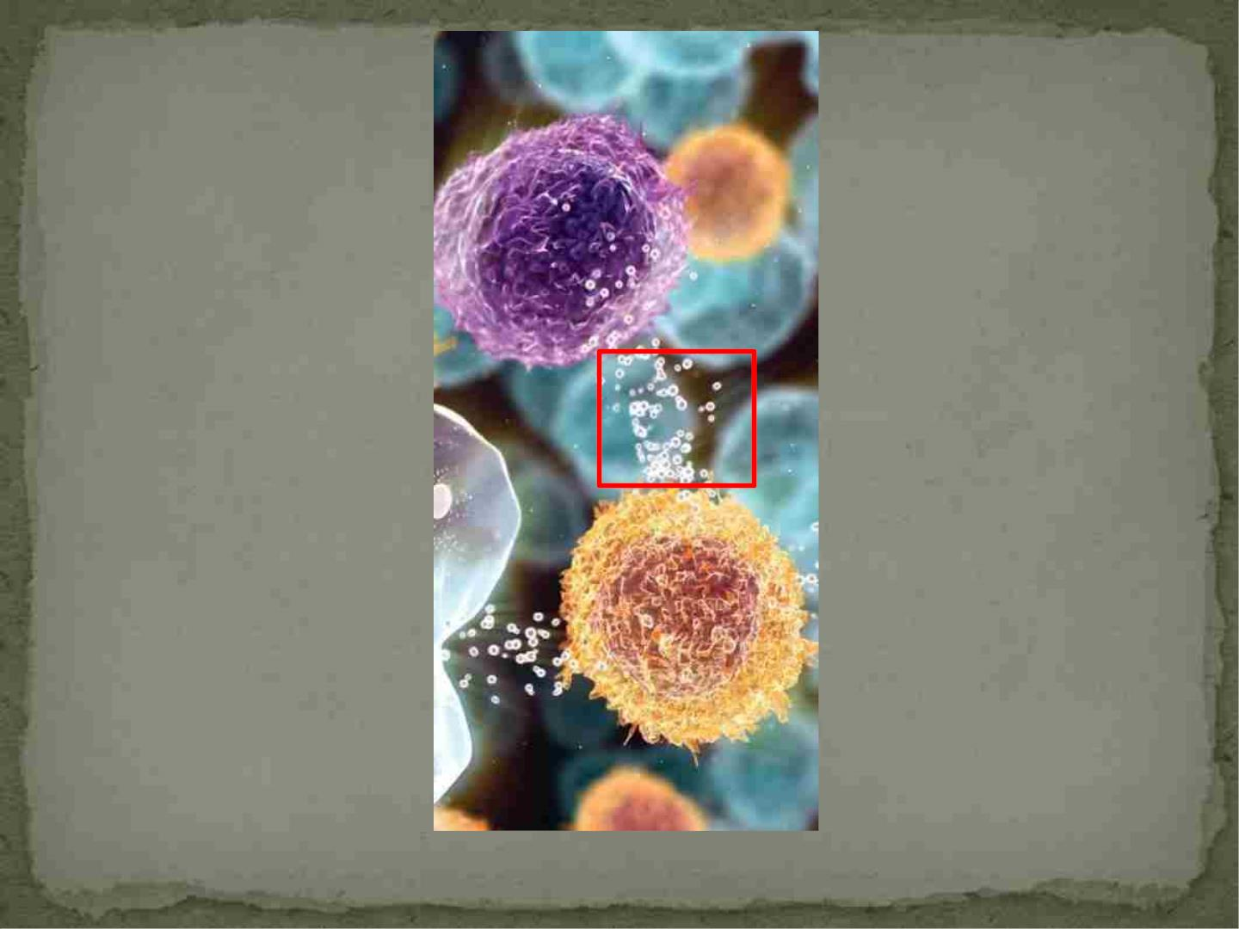
http://trialx.com/curebyte/2011/06/30/clinical-trials-and-images-of-cytokines/

Slide 58
Control of Immune Effector
Mechanisms
 Amount and type of cytokine produced
-there are more than 100 cytokines known
 Level of expression of cytokine receptors on immune
cells
 Different types of cells involved and how quickly they
can respond
 Antibodies that can recognize and bind to the
antigens

Slide 59
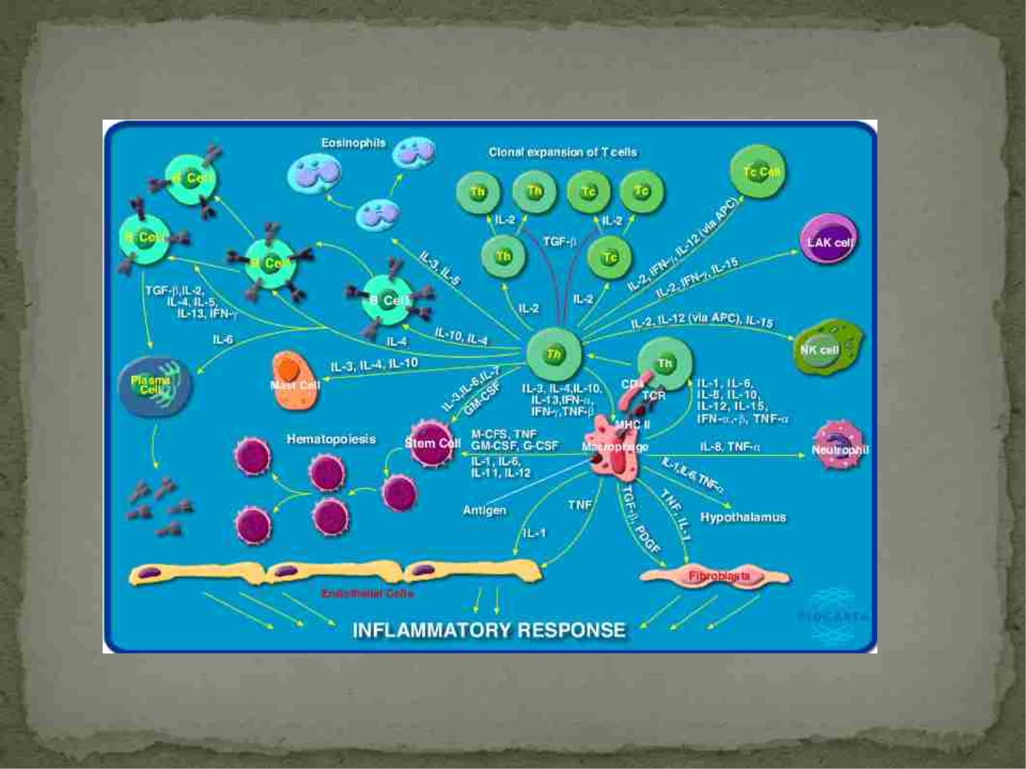
http://www.biocarta.com/pathfiles/h_inflamPathway.asp

Slide 60
How are target cells killed?

Slide 61
Two Types of T cells
 Helper T cells
-Express CD4 on their surface
-produce cytokines that help macrophages kill ingested organisms
-help B cells to differentiate into antibody producing cells
-activate other CD4 cells to expand clonally
-help cytotoxic T cells and NK cells kill target cells
-cells directly infected with HIV
-bind epitopes presented by MHC II
 Cytotoxic T cells
-Express CD8 on their surface
-Inhibit other cells or kill them
-bind epitopes presented by MHC I

Slide 62
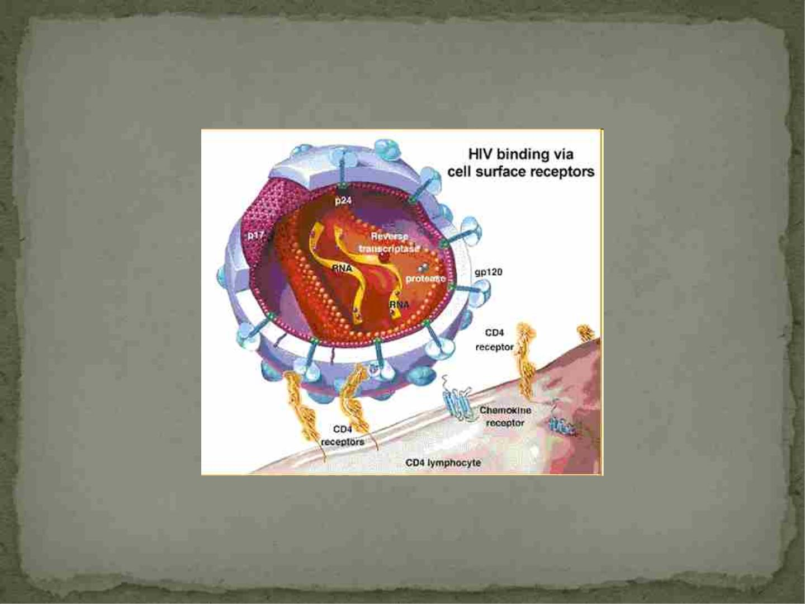
http://www.bio.davidson.edu/Courses/Molbio/MolStudents/spring2003/Cobain/geneprotein.html

Slide 63
Extracellular Immune Effector Mechanisms
 Extracellular organisms are protected against by:
- antibodies (B cells) and phagocytic cells
(macrophages)
-antibodies are secreted proteins produced by B cells
-the antibodies secreted by a particular B cell have the
same specificity as the antibody (receptor) on the
surface of the B cell

Slide 65
Extracellular Immune Effector Mechanisms
- Antibodies bind to whole antigens in their native
forms
-good defense against bacteria that can grow outside
of cells
-neutrophils ingest these bacteria but antibody
coating makes this easier
-they recognize the constant region of antibodies
-Opsonization
- directly interfere with the replication of pathogens
- prevent binding of intracellular pathogens to target
cells (HIV)

Slide 66
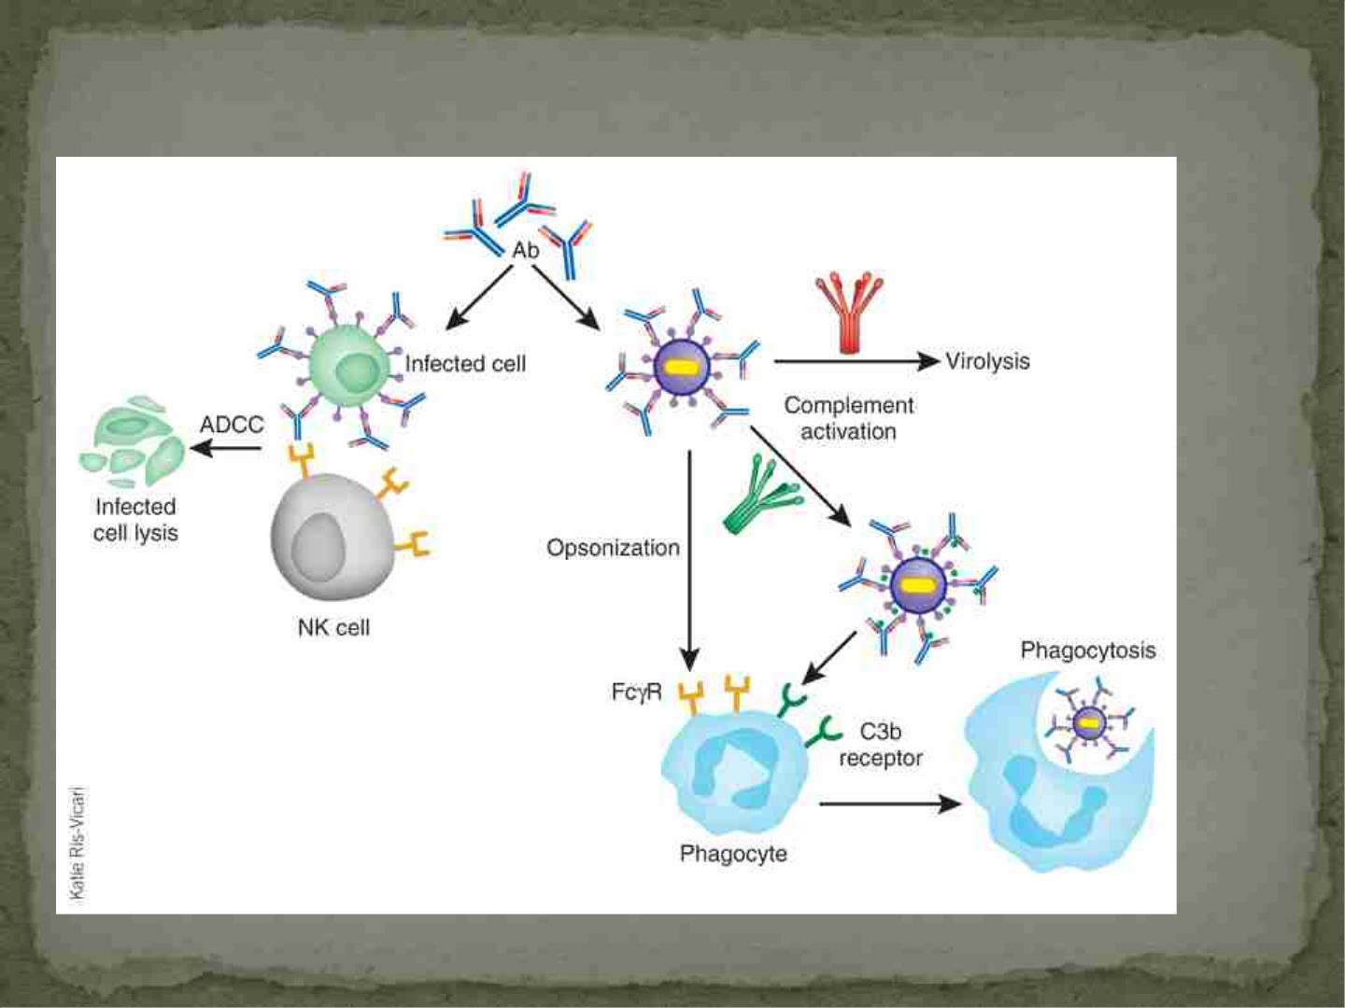
Process of Opsonization
(macrophage)

Slide 67
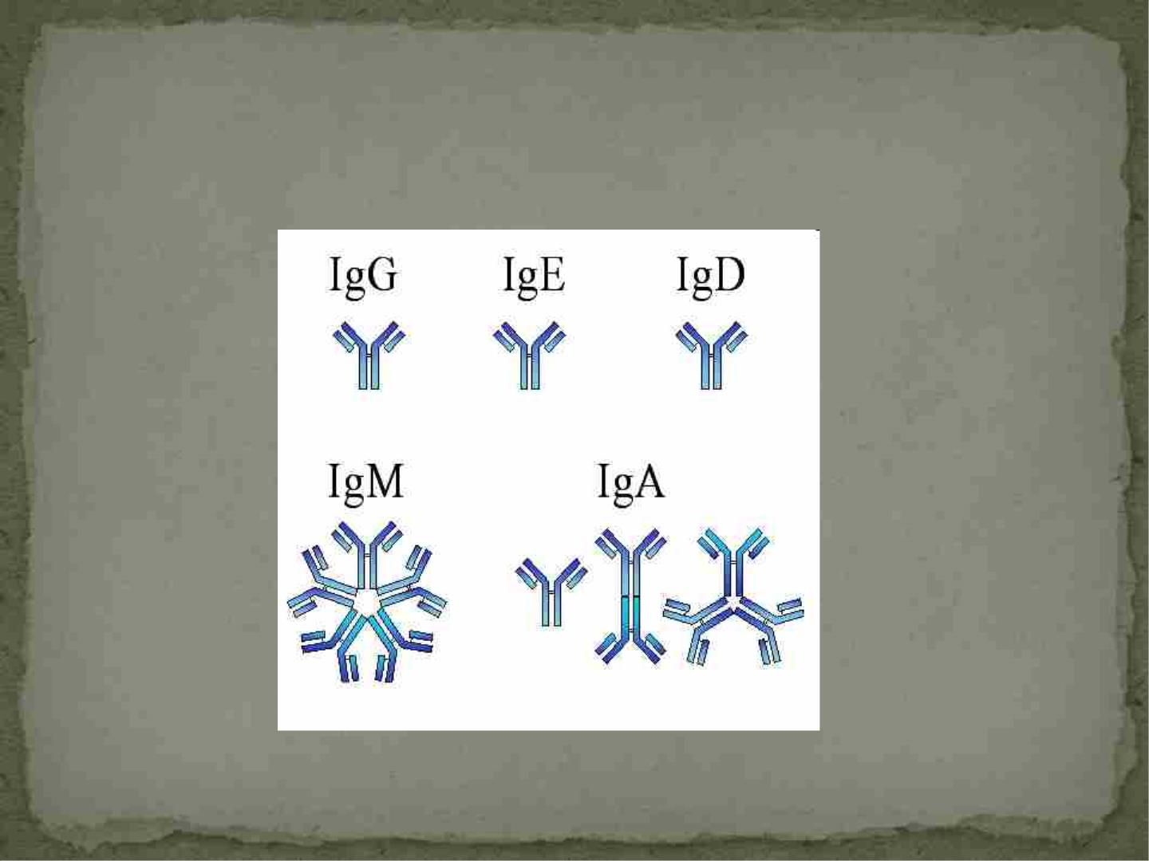
Different Types of Antibodies

Slide 68
Intracellular Immune Effector Mechanisms
 Virus infects cell
 Viral proteins are produced
 Peptides are carried to cell surface to MHC I
 Virus-specific CD8+ T cells can see this
 Interaction between MHC I peptide complex and T-
cell receptors
 Cell is killed by T cell
 This can happen faster than new virus production
 This is why all cells express MHC I- serves as immune
surveillance

Slide 69
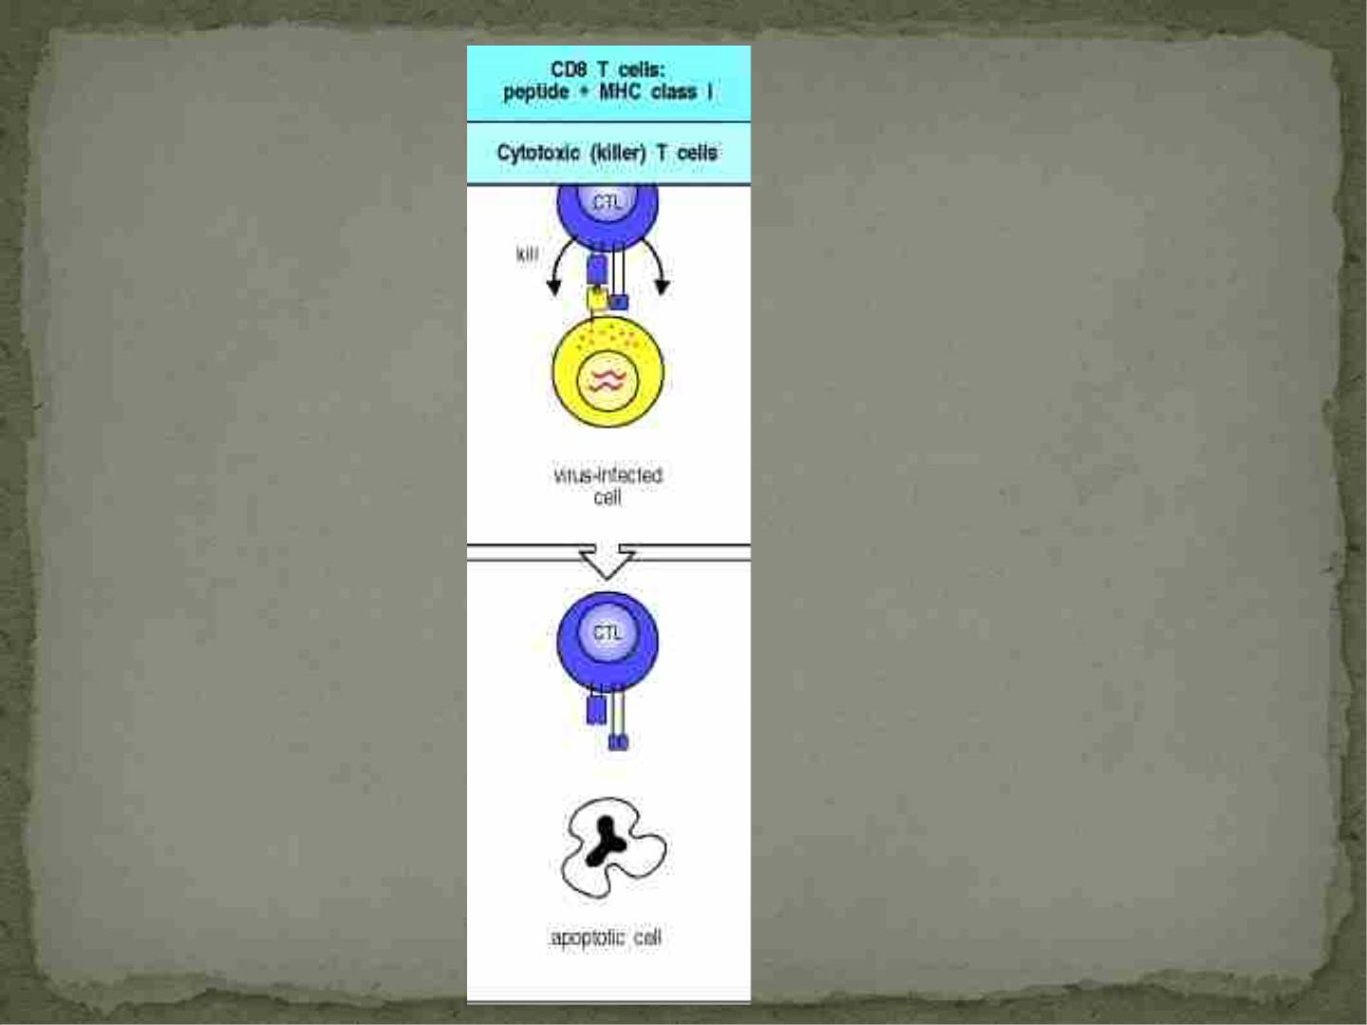
http://www.ncbi.nlm.nih.gov/bookshelf/b
r.fcgi?book=imm&part=A1062&renderty
pe=figure&id=A1063

Slide 70
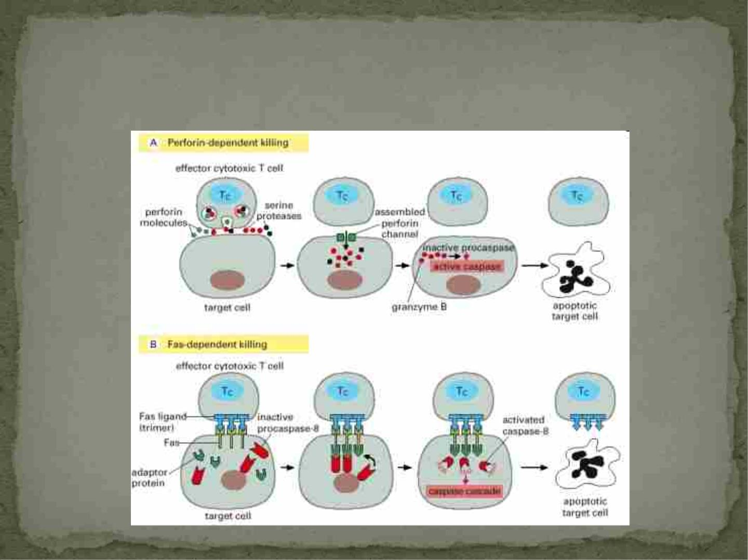
Intracellular Immune Effector Mechanisms

Slide 71
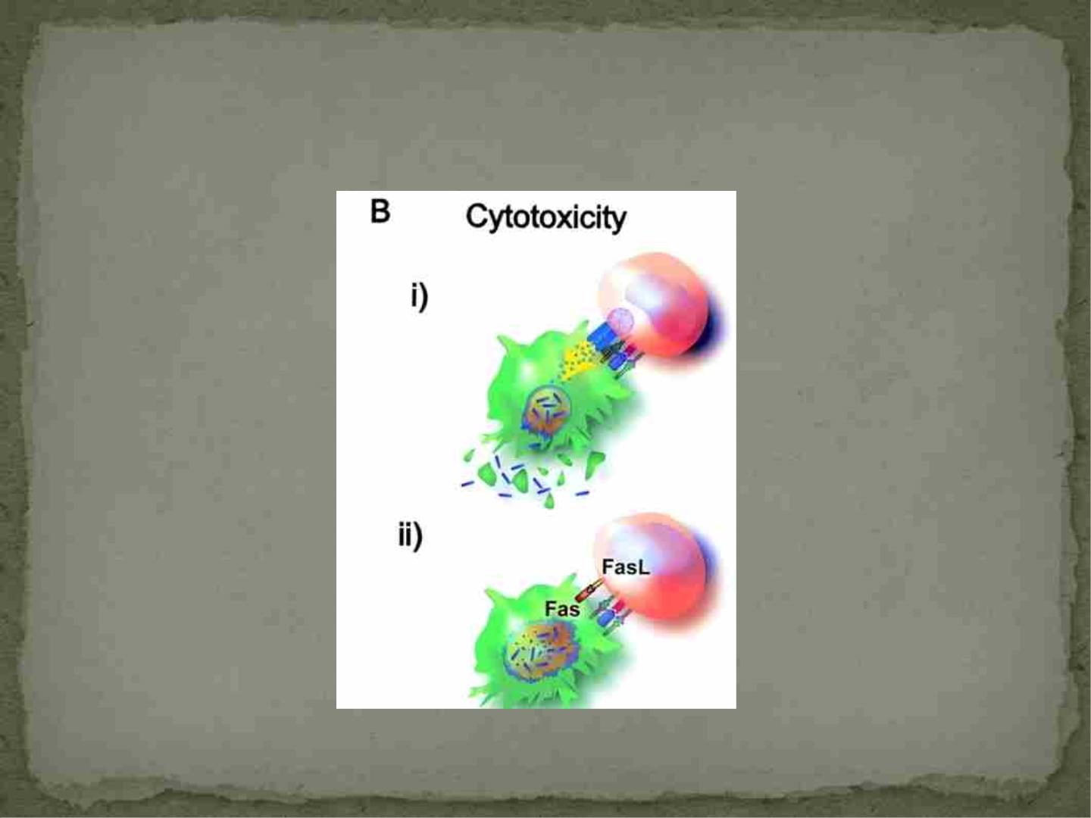

Slide 72
Intracellular Immune Effector Mechanisms
 MHC II uses an extracellular pathway as it is loaded
with peptides from antigens ingested outside of the
cell
 Used mainly by antigen-presenting cells
(macrophages, dendritic cells)

Slide 73
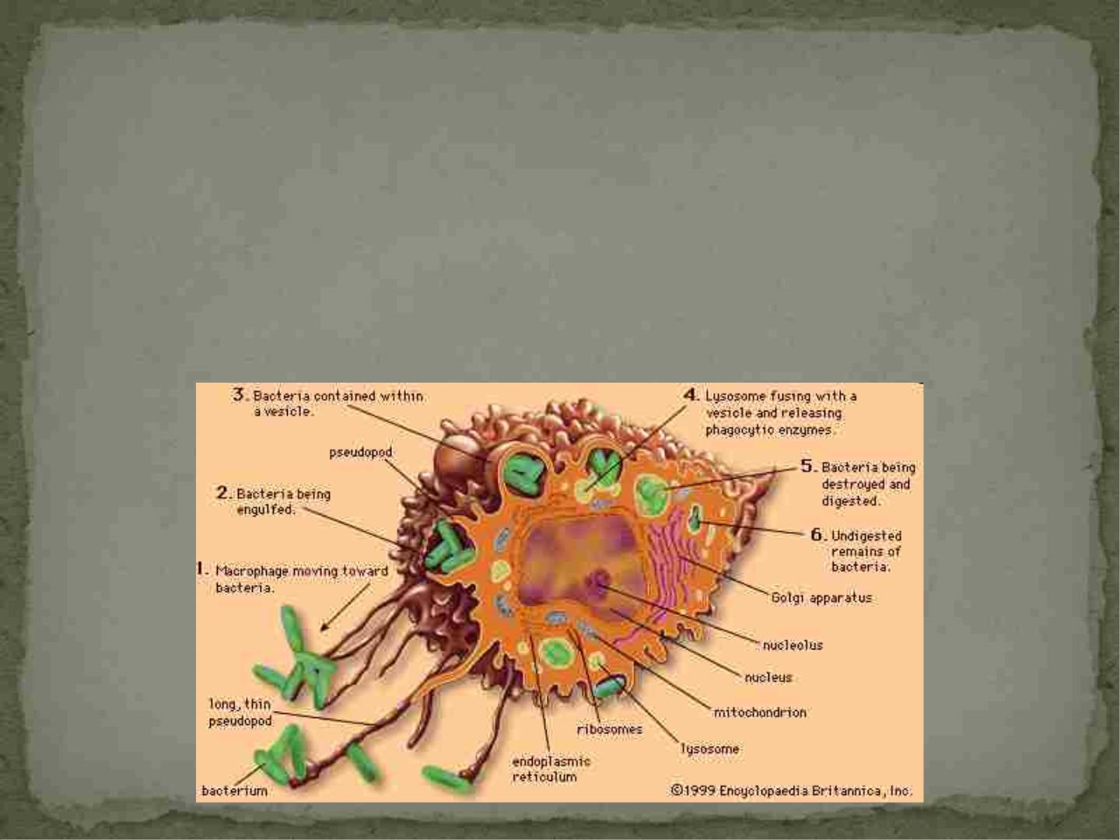
Intracellular Immune Effector Mechanisms
 Macrophages kill microorganisms they have ingested
-need activation by cytokines to help
-organisms covered in antibody are helpful
-interferon gamma is the best one

Slide 74
Innate Immune Cell Effector Mechanisms
 NK cells also depend on certain cytokines to make
them more effective
-IL-2 is needed to differentiate into activated killer
cells
 NK cells kill similar to cytotoxic CD8+ T cells
-use perforin/granzyme and the Fas/Fas ligand
method of inducing apoptosis
 NK cells also produce cytokines and are important in
regulating the immune response
 Neutrophils and macrophages can ingest antibody
coated organisms

Slide 75
Cytokines of Innate and Adaptive Immune
System
 Produced in small quantities and are very short lived
 They have many different functions and some are
redundant
 They usually bind very tightly to their receptors
 Cytokine receptors can bind more than one cytokine
 Very important regulators of the immune response

Slide 76
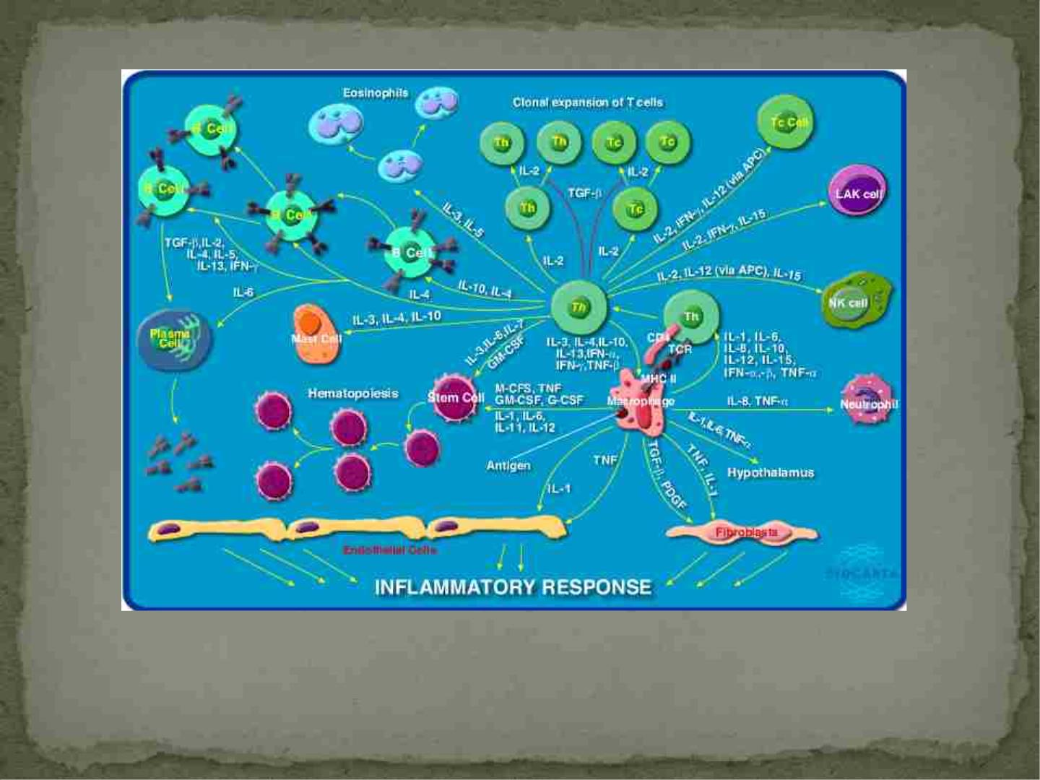
http://www.biocarta.com/pathfiles/h_inflamPathway.asp

Slide 77
When things go wrong…..

Slide 78
Tolerance and Regulation of the Immune
Response
 Immunological unresponsiveness to self is referred to
as tolerance or self-tolerance
 Very important to human health
 How is this achieved?
-cells with receptors for self-antigens are destroyed in
the thymus or bone marrow (central tolerance)
-self-reacting lymphocytes are made to become non-
responsive (anergy) or induced to self destruct
(peripheral tolerance)
-if this is not balanced well it leads to autoimmunity

Slide 79
Tolerance and Regulation of the Immune
Response
 The immune system also needs to regulate the length
and size of a response
 Long term inflammation is destructive to the host
 There is a wealth of data showing that chronic
immune infections such as CMV and HIV result in
premature aging of the immune system
 Toxic shock syndrome
-high numbers of activated T cells produced
-huge amount of cytokines produced
-leads to shut down of organ systems and sometimes
death

Slide 80
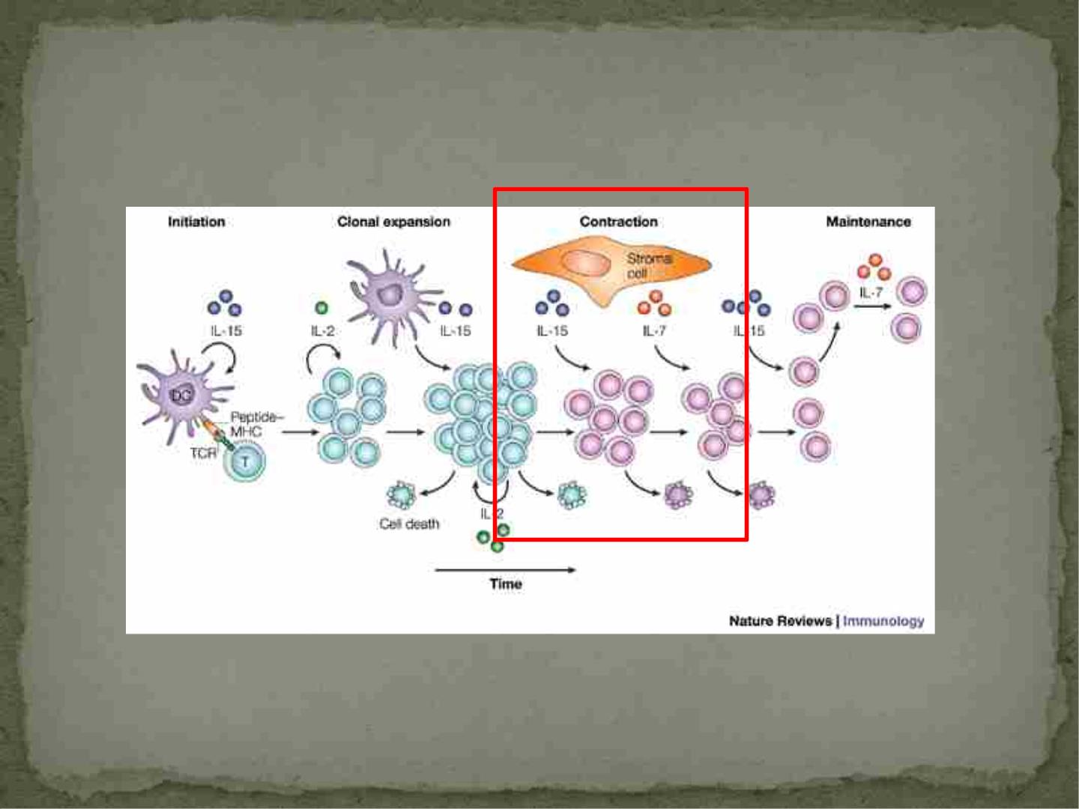
Schluns , et al. 2003

Slide 81
Immune Deficiencies
 B-cell Immune Deficiency
-host cannot make antibodies
-present with recurrent bacterial infections
-opsonization does not occur, phagocytes cannot
compete with growing bacteria

Slide 82
Immune Deficiencies
 T-Cell Immune Deficiencies
-recurrent infections with parasites, viruses and
intracellular bacteria
-see this in transplant patients suppressed to prevent
rejection
-seen in HIV infection which is known to deplete CD4+ T-
cells

Slide 83
Immune Deficiencies
 NK Cell Immune Deficiency
- initially thought to not have clinical importance
-13 year old girl presented with life-threatening
chicken pox infection
-had history of recurrent ear infections,
disseminated CMV infection, herpes simplex
virus infection with rash, etc..
-had no NK cells!!!
-important in controlling herpes virus infections
-herpes viruses are known to downregulate MHC I so
NK cells are important in controlling infection

Slide 84
Autoimmunity
 Autoimmune diseases:
-Diabetes, Rheumatoid Arthritis, Lupus, Multiple
Sclerosis
 Thought that regulation of the immune system is
involved, not just self-reactive lymphocytes
 Some genetic factors involved
-certain MHC alleles
-more women than men affected
 May be triggered by infectious organisms with
antigens similar to normal host antigens

Slide 85
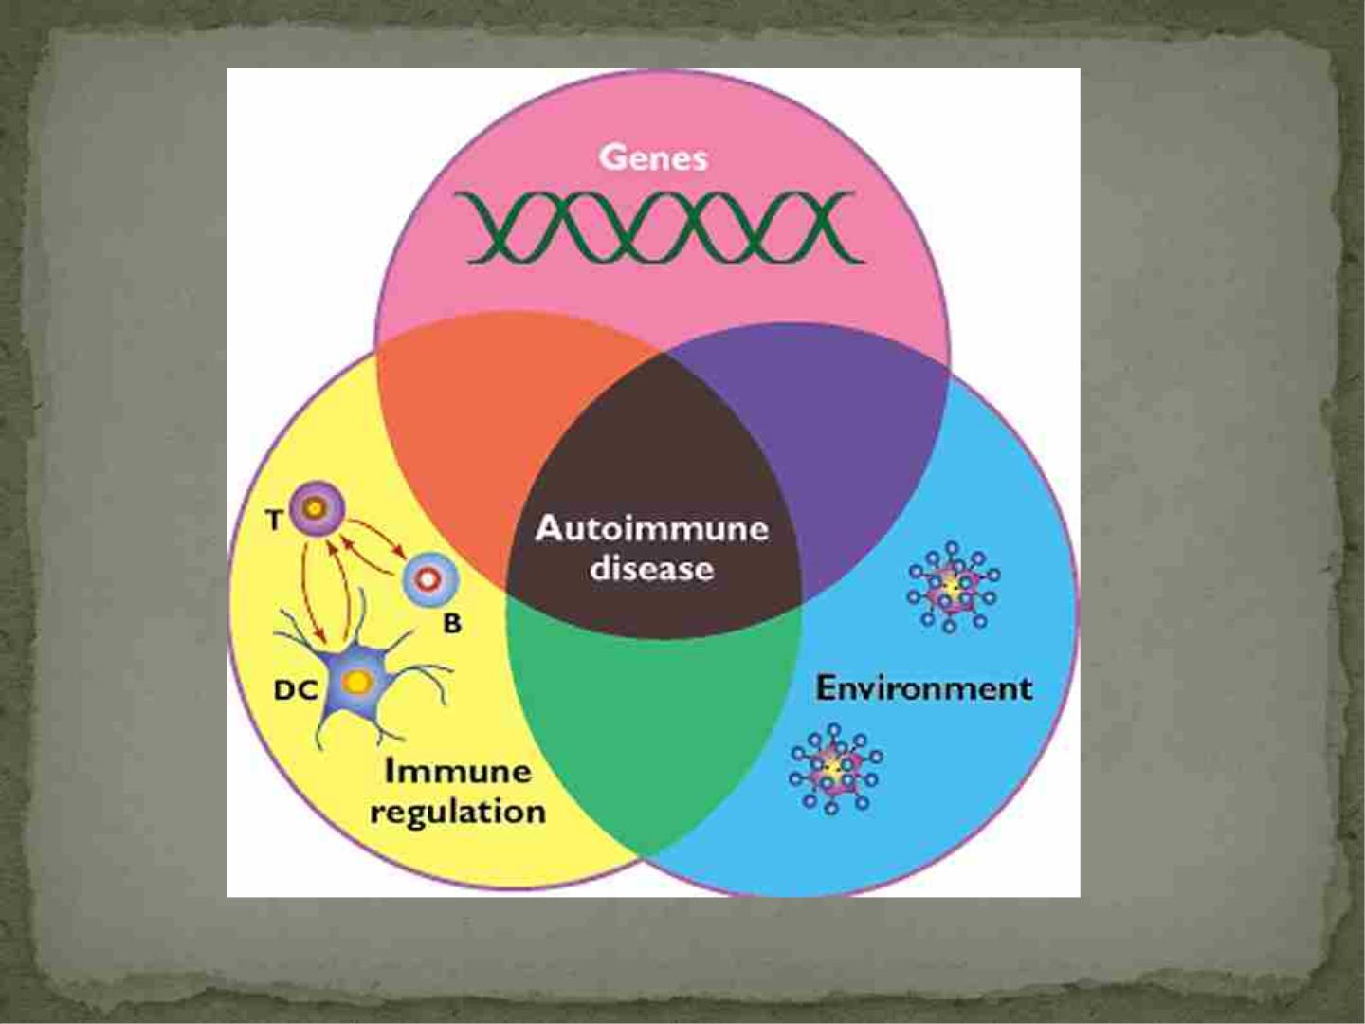
http://ashpauls.wordpress.com/autoimmune-diseases/

Slide 86
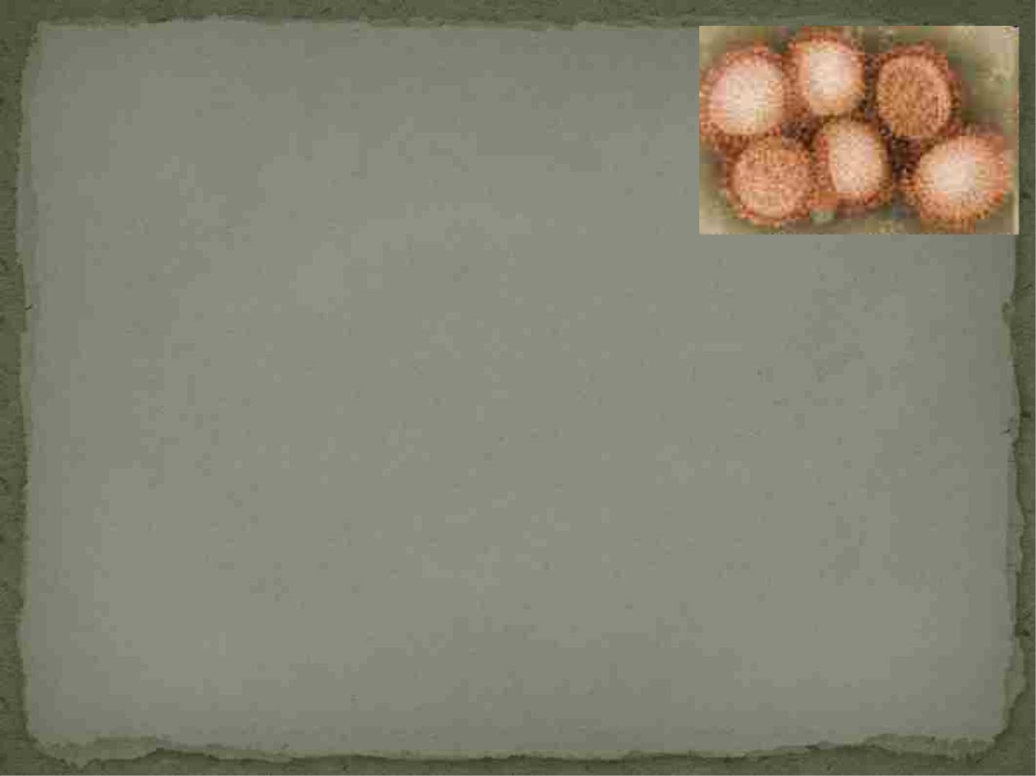
H1N1
 Why was it deadly??
-in some individuals they developed Acute Respiratory
Distress Syndrome
-due to the huge immune response and inflammation
that was triggered by the virus
 Why were elderly not at as much risk?
-appears there was a flu epidemic that they may have
been exposed to that gave their immune system some
“memory” against H1N1

Slide 87
Effects of Aging and HIV on the
Immune System

Slide 88
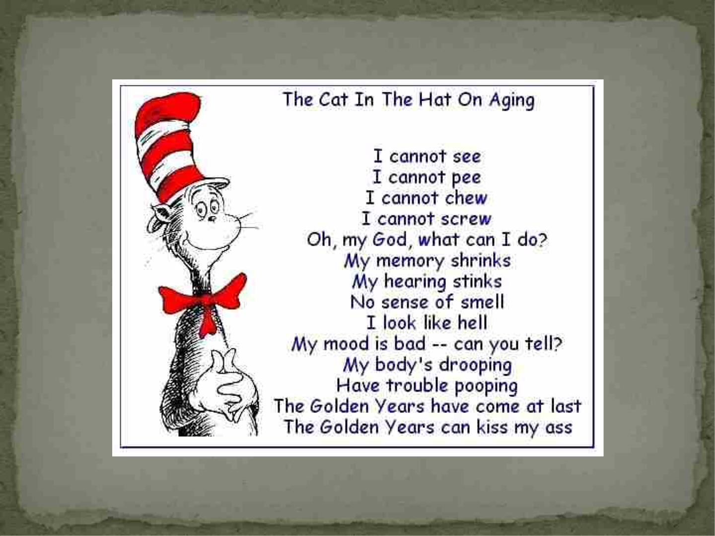

Slide 89
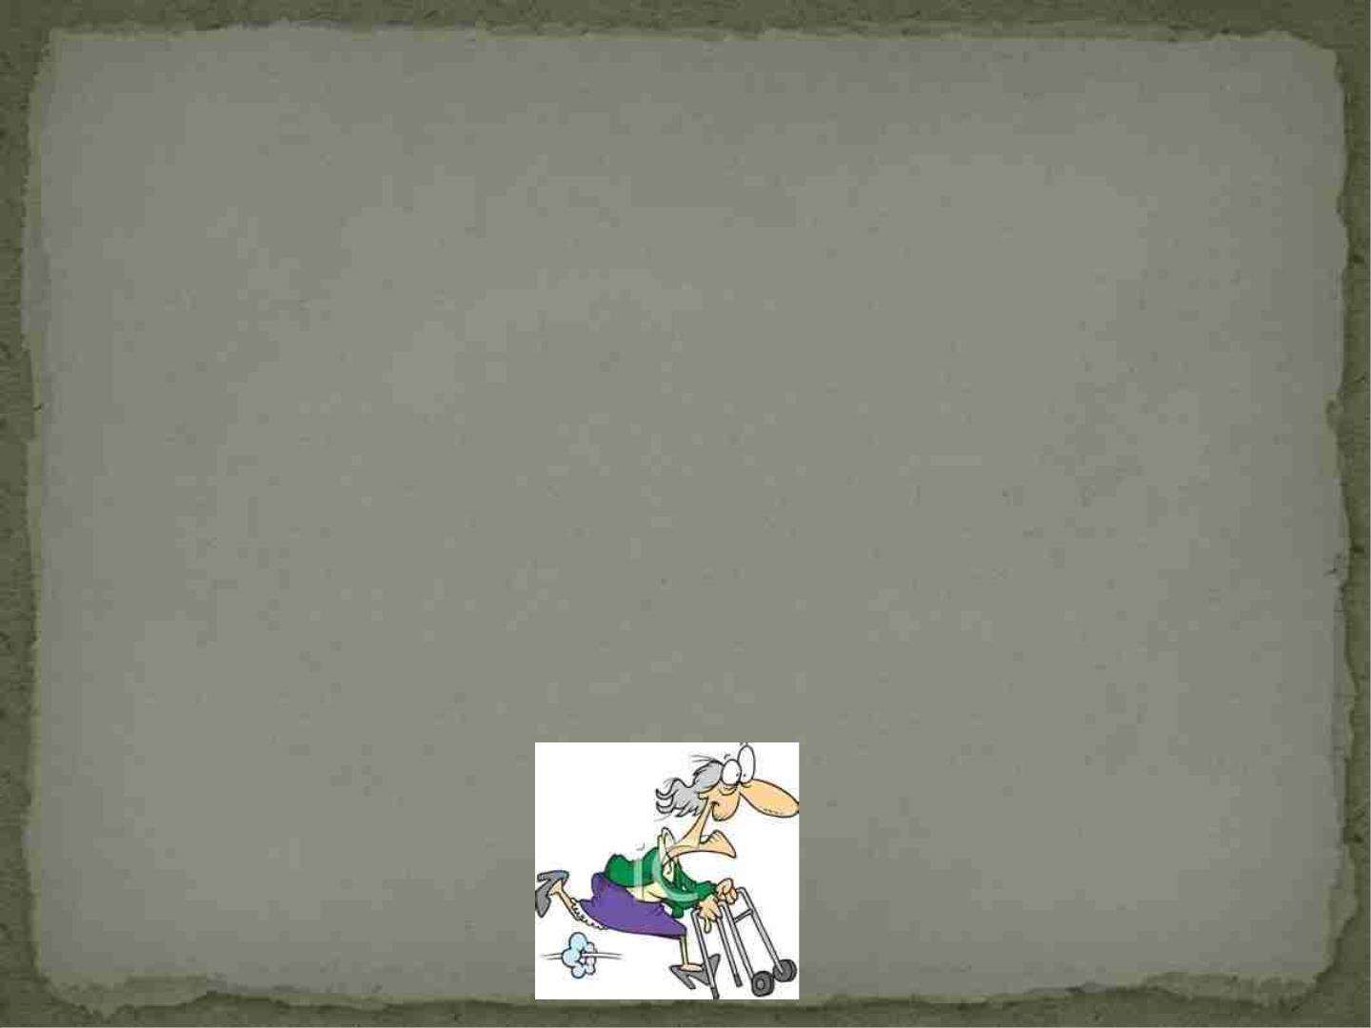
Aging
 Elderly people are more susceptible to infections
 Less protected by vaccines
 Infections in the elderly are characterized by more
severe symptoms, longer duration, and poorer
prognosis
 Reactivation of Varicella-Zoster, risks for pneumonia,
urinary tract infections, meningitis, TB and viral
gastroenteritis
 Related to age-related changes in the immune system

Slide 90
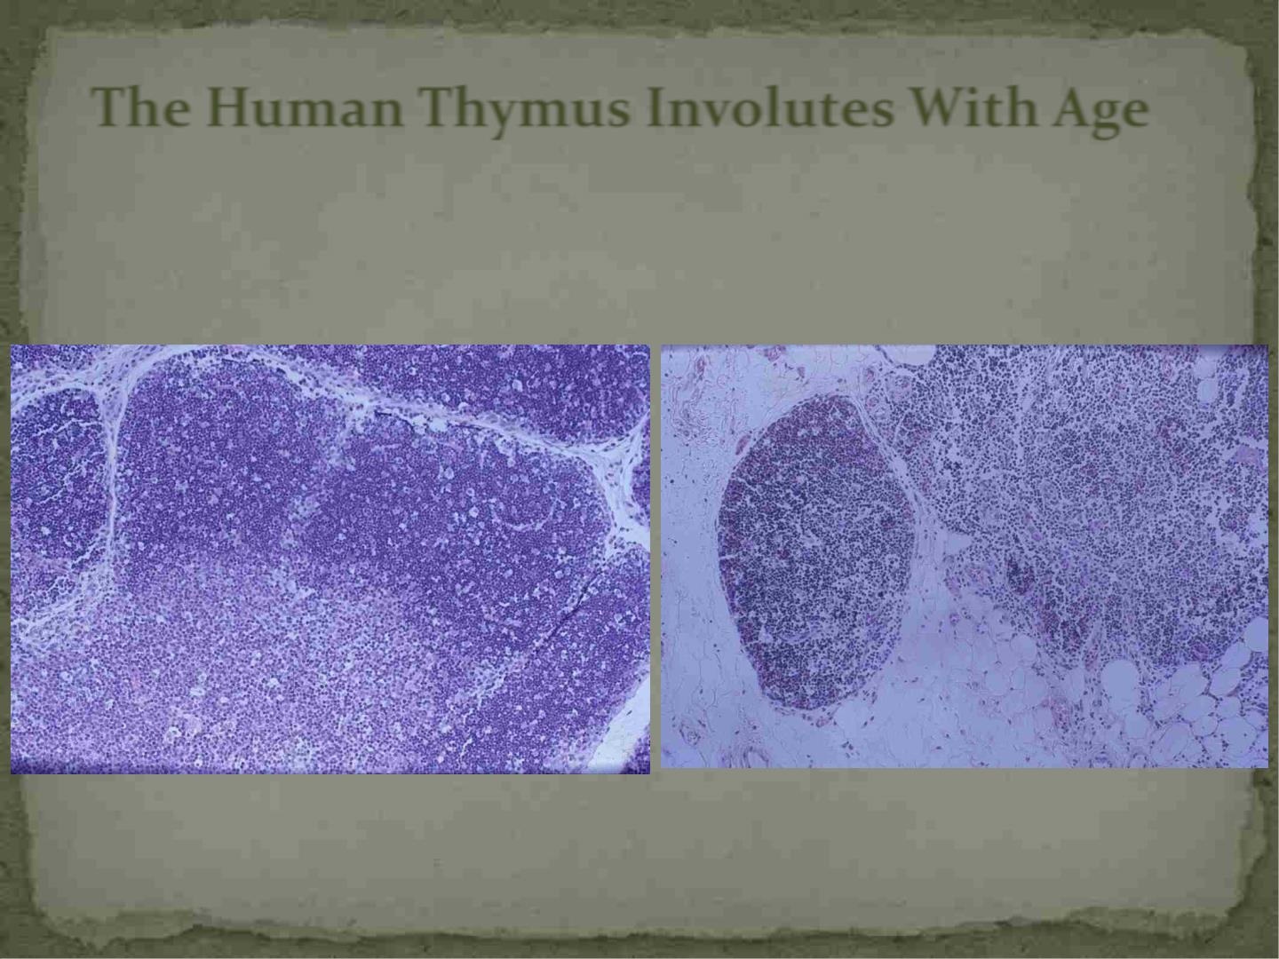
The Human Thymus Involutes With Age
Fetal Thymus
Adult Thymus
Jamieson, BD, et al, Immunity, 1999

Slide 91
Age-Associated Changes in
CD4⁺ T Cells
 Using cell surface markers normally used to identify
naïve T cells is difficult
 “naïve” cells in the elderly express receptors and
functional abilities more like memory cells
 Signaling and cytokine secretion in naïve CD4+ T cells
is altered and the activation potential of memory cells
is also decreased
 -hinders ability to mount effective immune responses
to antigens

Slide 92
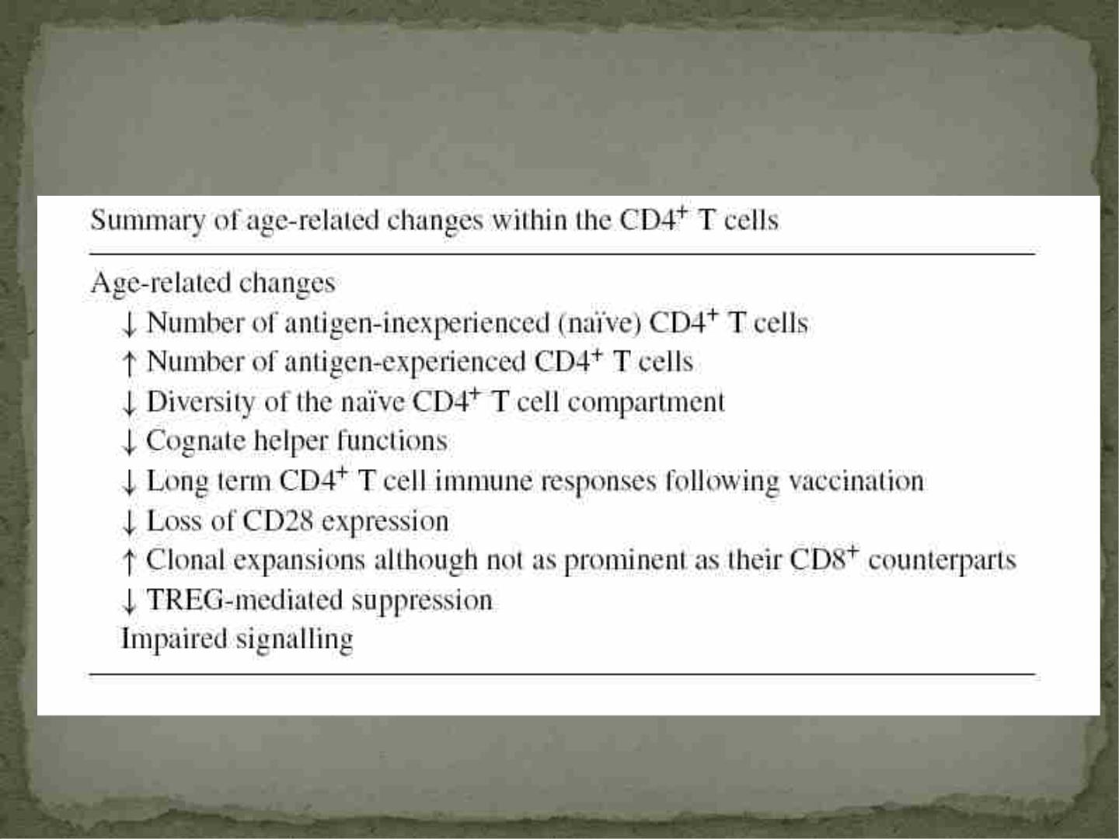
Age-Related Changes Within CD4⁺ T Cells
Kovaiou, Grubeck-Loebenstien, 2006

Slide 93
Summary of Age-Related Changes Within
CD8⁺ T Cells
 Increase in cells that can no longer functionally
respond to antigen
 Decrease in naïve CD8+ T cells
 See an increase in cells associated with chronic pro-
inflammatory status
 Increase in clonal expansions
 Decrease in T cell receptor diversity

Slide 94
Premature aging of the immune system in
HIV-1 infection: Is it the cause of AIDS???

Slide 95
Some Causes of Clinical
Immunodeficiency
 Not completely clear why the immune system initially
controls HIV-1 infection and then ultimately fails to
control viral replication
 Viral escape with mutations in epitopes recognized by
cytotoxic T lymphocytes (CD8+ T cells)
 Functional impairment of HIV-specific CD8+ T cells
 High levels of immune activation

Slide 96
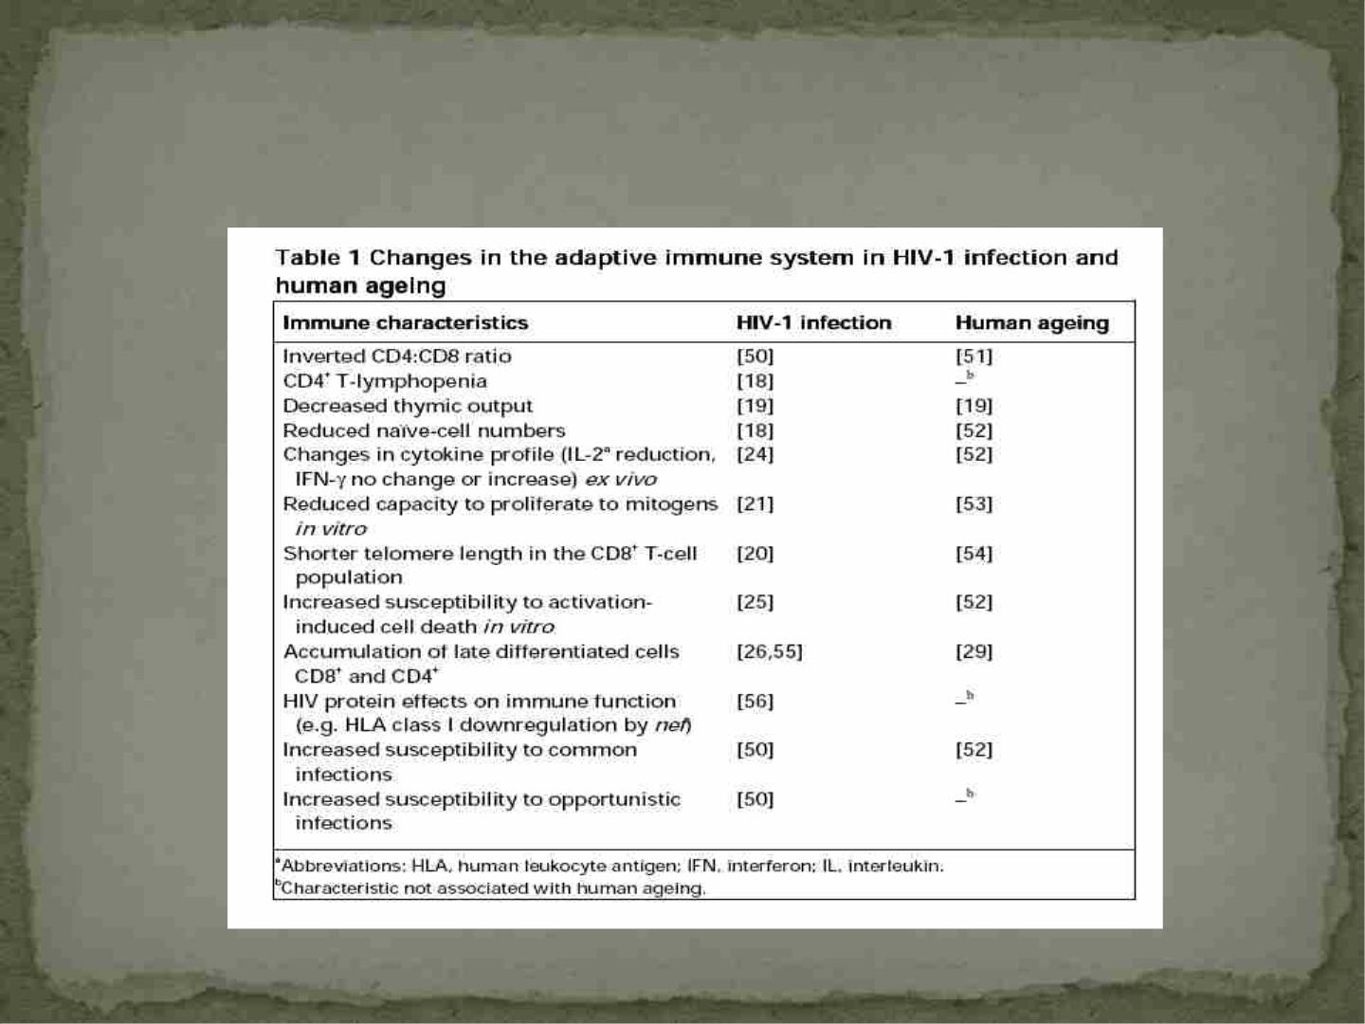
The Adaptive Immune System in Aging
and HIV-1 Infection
Appay, V and Rowland-Jones, SL, Trends in Immunology, 2002

Slide 97
Parallels Between HIV-1 Pathogenesis and
Human Aging
 Lifespan of both CD4+ and CD8+ T cells is shortened to
about a third of normal
-increase of CD8+ T cells but CD4+ cannot keep up with
the pace of destruction
 Increase in the amount of terminally differentiated T cells-
consequence of immune activation
-leads to immunosenescence, also occurs with CMV
-get an accumulation of immune cells that cannot
function or replicate normally, but are more resistant
to apoptosis
 AIDS is much more severe immune senescence than what
is seen in normal aging

Slide 98
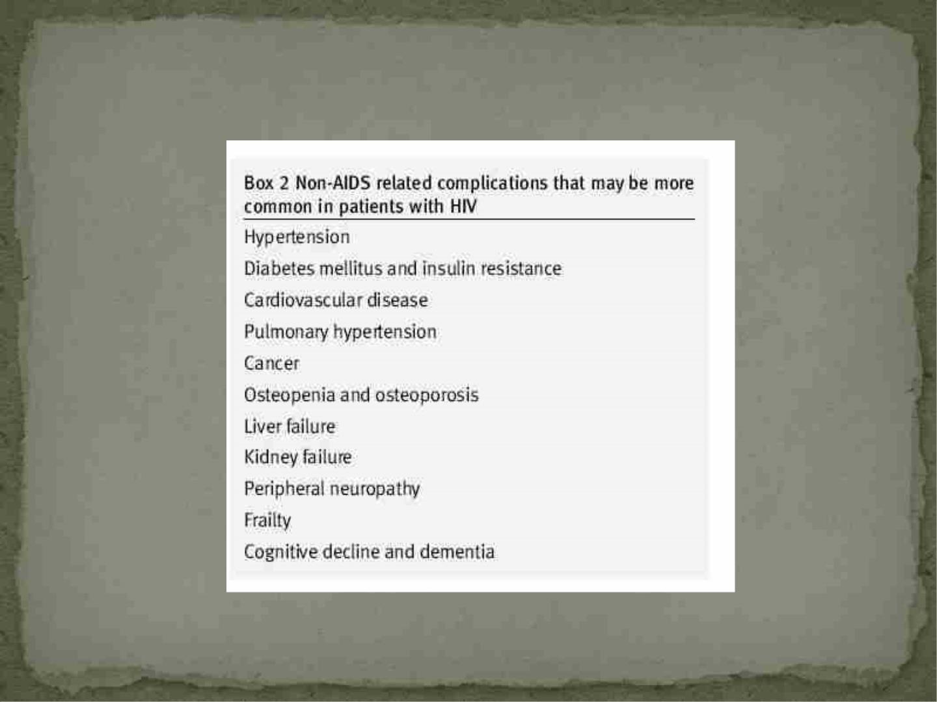
Age-related Diseases Diagnosed in HIV+
Individuals
Older HIV+ individuals are at even greater risk due to normal
immunological aging coupled with aging caused by HIV-1 infection

Slide 99
Conclusions
 The immune system is made up of two different
components that work separately and together
 Both systems are necessary for efficient protection
against pathogens
 Proper regulation of these processes is imperative for
the health of the host

